Slide 2
Introduction
  This third paper in the MASC School Accountability Series articulates a vision of school improvement expanding upon the positive outcomes and negative consequences derived from 20 years of school accountability implementation based on lessons learned articulated in two previous papers.
  Given that education legislation has the specificity of regulations, policy makers must understand these successes, challenges, missteps, and lessons before enacting legislative modifications.
  Labeling schools and districts as “failures” and imposing government-mandated, compliance-driven “solutions” has not worked.
  In crafting successor legislation, the Joint Committee on Education should consult with MASC, Mass Partners for Public Schools, researchers, educators, students, and families to determine what is and is not working based on actual implementation practices and outcomes from the myriad reform initiatives imposed by state and/or federal mandates.
  Local control of decision-making at the school and district levels is imperative. We believe a priority must be to create legislative language leading to the adoption community schools guided by the six core principles as key to providing all our school-aged children with the education to which they are constitutionally entitled.
  Supporting families by making schools centers of community engagement is critical, especially for students living at or below the poverty level.
  It is time for all of us to articulate public education legislative priorities and language based on and acknowledging our mutual responsibility to create the conditions and provide the funding for excellent educational experiences focused on children and their families.

Slide 3
Education Obligation in Massachusetts Constitution
  Massachusetts Constitution, Chapter V, Section II
The Encouragement of Literature, etc. “Wisdom, and knowledge, as well as virtue, diffused generally among the body of the people, being necessary for the preservation of their rights and liberties, and as these depend on spreading the opportunities and advantages of education in the various parts of the country, and among the different orders of the people, it shall be the duty of legislatures and magistrates, in all future periods of this commonwealth, to cherish the interests of literature and the sciences, and all seminaries of them, especially the university at Cambridge, public schools and grammar schools in the towns, to encourage private societies and public institutions, rewards and immunities, for the promotion of agriculture, arts, sciences, commerce, trades, manufactures, and a natural history of the country, to countenance and inculcate the principles of humanity and general benevolence, public and private charity, industry and frugality, honesty and punctuality in their dealings, sincerity, good humor, and all social affections, and generous sentiments among the people.”
  Massachusetts General Laws, Chapter 69, Section 1
  It is hereby declared to be a paramount goal of the commonwealth to provide a public education system of sufficient quality to extend to all children including a limited English proficient student and also, including a school age child with a disability the opportunity to reach their full potential and to lead lives as participants in the political and social life of the commonwealth and as contributors to its economy. It is therefore the intent of this title to ensure:
  that each public school classroom provides the conditions for all pupils to engage fully in learning as an inherently meaningful and enjoyable activity without threats to their sense of security or self-esteem,
  a consistent commitment of resources sufficient to provide a high quality public education to every child,
  a deliberate process for establishing and achieving specific educational performance goals for every child, and
  an effective mechanism for monitoring progress toward those goals and for holding educators accountable for their achievement.

Slide 4
MASC Legislative Goals. In crafting legislation, MASC recommends the Joint Committee on Education consider the following goals while assuring equitable advocacy and concern for the civil rights of all students, especially those at economic risk
Define public education as a state-funded benefit for children leading to post-secondary career, college, or community service.
Promote local control and the community school model focused on collaborative decision-making, broad academic programs, embedded family support, and school-based health and social services as a means of addressing those schools needing assistance.
Prioritize the best interests of children and their families in order to improve student achievement, social and emotional well-being, economic security, and good citizenship.
Address poverty, social, and emotional well-being of students and families, and professional morale as a guiding legislative purpose.
Safeguard student rights to privacy and security, including how data is gathered, used, shared, or stored.
Minimize regulatory intrusions and control the ability of the state to impose many of the kinds of compliance-driven, time consuming mandates upon school districts.
Develop a school performance system in collaboration with Mass Partners for Public Schools as a means of improving outcomes for students and professional practice for educators.
Undo school accountability mandates resulting in negative school and district labeling resulting in a punitive system of sanctions.
Protect the interests of students, parents, community members, and educators over those of individuals and organizations that would seek to profiteer, exploit their own interests, or otherwise exercise illegitimate control over the education of children.

Slide 5
MASC Legislative Recommendations. In crafting legislation, MASC recommends the Joint Committee on Education consider the following goals while assuring equitable advocacy and concern for the civil rights of all students, especially those at economic risk
I. Devise metrics that identify schools as either “in need of assistance” or “not in need of assistance” based on both quantitative and qualitative measures.
II. Articulate legislative language that requires schools designated as underperforming or chronically underperforming to adopt school redesign plans based on the six community schools principles.
  A strong proven, comprehensive curriculum encompassing all curriculum frameworks for all students leading to the successful completion of MassCore as the competency determination for high school graduation.
  High-quality teaching by educators who are fully-licensed by holding Professional Teacher licenses, knowledgeable about their content, and skillful in their practice. School day time is carved out for teachers to work collaboratively analyzing student work and adjust curriculum.
  Collaborative, inclusive leadership guided by principals who hold both Professional Teacher and Professional Administrator at the appropriate school level. The team shares responsibility for school operations with the principal.
  Positive behavioral practices using restorative discipline practices including peer mediation, community service, and post-conflict resolution to help students learn from their mistakes and foster positive, health school climates.
  Family and community partnerships in which parents, caregivers, and community members create dynamic, flexible community schools on a committed, on-going basis.
  Community support services that address the challenges impacting students’ ability to learn, explore, and develop in the classroom. These services include meals, health care, mental health counseling, and other appropriate services. The ASCD’s Whole Child tents should guide this work.
  III. Fund schools designated as underperforming or chronically underperforming to enable them to create and implement school design plans addressing the six community schools principles.

Slide 6
Positive Impacts. MASC identified positive impacts of education reform statutes that policy makers should understand and build upon when drafting successor legislation. Including educator, student, family, and school committee voice is critical to learning what has worked and what has not. Such tangible knowledge helps all of us to better serve our children and their families
  School Funding: Establishing Chapter 70 codified the foundation budget system defining the minimum funding to provide all students an adequate education based on a community’s ability to pay. This increased state aid to low-income and low-wealth communities.
  Curriculum Standards: The adoption of the seven curriculum frameworks defining what all public school students should know and be able to do in the arts, English language arts, foreign languages, health, history & social studies, mathematics, and science, engineering & technology. As a result, more students have access to teaching and learning in these broad areas.
  Educator Preparation: Greater emphasis on educator preparation through a tiered licensure system and on-going professional learning throughout an educator’s career has resulted in high-qualified teachers and school leaders.
  Instructional Materials: Districts purchased textbooks, software and other instructional materials aligned to the curriculum frameworks standards. Students are more likely to have instructional materials that provide them with rich learning experiences.
  Student Performance on Large-Scale Sample Testing: Massachusetts students have consistently out-performed their peers on national and international standardized tests:
  National Assessment of Education Progress (NAEP). First in /Grade 4 and tied for first in Grade 8 Reading. Tied for first in Grades 4 and 8 mathematics.
  Program for International Student Assessment (PISA). Scored highest in reading, second in science internationally.
  Trends in International Mathematics and Science Study (TIMMS). Fifth in the world in Grade 8 math. Second in the world in Grade 8 science.

Slide 7
Negative Consequences. MASC articulated negative consequences from 20 years of implementation of education reform statutes. The elimination of statutory language resulting in negative impact on students, families, educators and schools must be a priority when drafting successor legislation.
Curriculum Frameworks Revisions. MCAS tested subjects have been revised multiple times over the past two decades, while untested frameworks have not.¹
Obscure, Misguided Measure. The ”one-size-fits-all” metric identifying school performance based on that which can be either tested or counted – test scores, attendance, graduation rates – is “junk science,” an untested, unproven theory presented as scientific fact.
Breadth of Teaching and Learning. Schools assessment does not address the statutory intent. Actual school work, school programs, student engagement, school climate are ignored. The accountability designation fails to assess the depth and breadth of teaching and learning within any school.
Excessive, Arbitrary Accountability Designations. Identifying the lowest 10 or 20 percent of elementary, middle, and high schools by a misguided metric as in need of focused or targeted assistance is arbitrary.
Decision-Making Authority. Vesting decision-making authority in the Commissioner to negatively label schools and imposed state-dictated solutions results in unintended negative consequences for districts.²
Failure to Attract and Retain Highly Qualified, Experienced Educators. Negative school labels create conditions that drive qualified, skilled, experienced educators away resulting in schools staffed by underprepared and inexperienced educators.
Failure of External Turnaround Partners. Assigning receivership authority to external partners selected by the Commissioner has been unsuccessful. In all cases, external partners have left either prior to or at the end of their contract expiration. Public dollars have been expended to little effect, but with great disruption to the school staff, students and their families.
Undercutting Local Control of Schools. Through the turnaround plans, the Commissioner is transferring school committee authority and responsibility to the superintendent or an external receiver. The voices of constituents, parents, students, educators and local elected officials is minimized or eliminated. The collective expertise of those at the local level is substituted by the decisions made by staff at the Department of Elementary and Secondary Education.

Slide 8
Community School Legislative Recommendation. identify high-need schools based on quantitative and qualitative measures. Require locally controlled inclusive leadership committees to develop school redesign plans using the six community schools principles providing.
Adopt community schools model that establishes policies, practices, and procedures that bring together academics, health and social services, youth and community development, and community engagement under one roof. Creating the foundation for healthy behaviors and laying the groundwork for educational attainment, developmental needs, and social-emotional well-being supporting students, staff, and families leads to improved learning, stronger families, and healthier communities.
Because learning does not happen in isolation, community schools provide meals, health care, mental-health counseling, and other services fore, during, and after school. These wraparound services are integrated into the fabric of the school. Connections to the community are critically important so support services and referrals are available for families and other community members.
Acknowledge families, caregivers, and community members as equal partners in creating dynamic, flexible community schools. Their voices are critical to articulating and achieving the school’s overall mission and goals. When families and educators work together, students are more engaged learners who earn higher grades and enroll in more challenging classes, student attendance and grade and school completion rates improve.
The Whole Child Approach transitions from narrowly defined focus on academic achievement based primarily on tested subjects to one that promotes long-term development and success of all children. Educators, families, community members, and policymakers develop and implement policies resulting in schools addressing all aspects of child and adolescent development.
Each student enters school healthy and learns about and healthy lifestyle practices.
Each student learns in an environment that is physically and emotionally safe for students and adults.
Each student actively engages in learning and connects to the school and broader community.
Each student has access to personalized learning and is supported by qualified, caring adults.
Each student is challenged academically and prepared for success in college or further study and for employment and participation in a global environment.

Slide 9
Six Principles of the Community Schools Model
Strong, Proven, Comprehensive Curriculum: Students experience a rich, varied academic program to acquire both foundational and advanced knowledge and skills in Massachusetts’ mandatory content areas. Curricula are challenging, culturally relevant, and address students’ learning needs and expand their experience.
High-Quality Teaching by Great Educators: Accomplished, effective teachers are fully licensed, knowledgeable about their content, and skillful in their practice. Instructional time focuses on learning rather than testing. Individual student needs are identified and learning opportunities are designed to address them.
Collaborative, Inclusive Leadership: Leadership teams with educators and other school staff share the responsibility of school operations with the principal. This leadership team ensures the community school strategies and practices remain central in the decision-making process.
Positive Behavior Practices: Educators emphasize positive relationships and model these through their own behavior. Negative behaviors are acknowledged and addressed through restorative discipline practices that hold students accountable while showing them they are still valued members of the school community.
Family and Community Partnerships: Parents, caregivers and community members are partners in creating dynamic, flexible community schools. Their engagement is not related to a specific project or program, but is on-going and extends beyond volunteerism to roles in decision-making, governance and advocacy.
Community Support Services: Because learning does not happen in isolation, community schools provide meals, health care, counseling, and other services integrated into the fabric of the school. Following the Whole Child tenets, social service connections and referrals are available for families and other community members.

Slide 10
Community Schools serving high-need populations provide students and their families with connections to the social safety net. Community schools bring together academics, health and social services, youth and community development and engagement under one roof, leading to improved learning, stronger families, and healthier communities.
Recognizing that economic insecurity is a barrier that must be addressed in order to improve academic outcomes for all students and to provide a path to secure multi-agency collaboration supporting children and their families is a key goal of Community Schools.
While all public schools are located within a community, the majority are not “community schools.”
A Community School becomes the center of the community in which it resides.
The U.S. Department of Education, states that “Full-Service Community Schools provide comprehensive academic, social, and health services for students, students’ family members, and community members that will result in improved educational outcomes for children. These services may include: high-quality early learning programs and service, remedial education, aligned with academic supports and other enrichment activities, providing students with a comprehensive academic program, family engagement, including parental involvement, parent leadership, family literacy, and parent education
programs, mentoring and other youth development programs, community service and service learning opportunities, programs that provide assistance to students who have been chronically absent, truant, suspended, or expelled, job training and career counseling services, nutrition services and physical activities, primary health and dental care, activities that improve access to and use of social service programs and programs that promote family financial stability, mental health services, and adult education, including instruction of adults in English as a second language.”
Source: US Department of Education

Slide 11
Academic Program Legislative Recommendation. Community schools provide academic programs guaranteeing all students access to the Commonwealth’s broad curriculum frameworks leading to successful completion of MassCore by Grade 12. All frameworks must be updated by practitioners on a predictable timeframe that ensures the most up-to-date information is being provided to students.
The Comprehensive Health framework has not been revised in 20 years. Significant research findings and recommendations addressing how to address students’ social and emotional well-being, to inform them about nicotine, vaping, opioid, drug, and alcohol addiction, to impact their diet and exercise to curtail obesity problems, to understand health sleep habits, to confront bullying behaviors, and to learn elements of dispute resolution.
With the adoption of the Elementary and Secondary Education Act as the ‘No Child Left Behind Act’ in 2000, the requirement that all students be tested in reading and mathematics in elementary, middle, and high school has driven the revisions of these curriculum frameworks.
As indicated below, History & Social Science was revised in 2018, 15 years after the last change. Science, Technology & Engineering, fields that have shown enormous changes, went 10 years from 2006 before being revised. In 2016 While Foreign Languages, The Arts, and Comprehensive Health have not been revised in 20 years.
Current Frameworks Adoption & Revisions | Adopt | #1 | #2 | #3 | #4
English language arts | 1997 | 2001 | 2004 | 2011 | 2017
Mathematics | 1996 | 2000 | 2004 | 2011 | 2017
Science, Technology & Engineering | 1996 | 2001 | 2006 | 2016
History & Social Science | 1997 | 2003 | 2018
Foreign Languages | 1996 | 1999
The Arts | 1996 | 1999
Comprehensive Health | 1996 | 1999
Digital Literacy & Computer Science | 2016
Vocational Technical | 2014

Slide 12
Academic programs guarantee all students learning experiences related to the content outlined in the Commonwealth’s Curriculum Frameworks. However, legislation must articulate a vision beyond what might now be consider basic.
  The MERA of 1993 states, “A paramount goal of the commonwealth to provide a public education system of sufficient quality to extend to all children including a limited English proficient student and also, including a school age child with a disability the opportunity to reach their full potential and to lead lives as participants in the political and social life of the commonwealth and as contributors to its economy."
  Broaden academics to include areas lost over the past 20 years, especially skills such as civic engagement, understanding government, and determining fact vs. fiction,
  Academic programs should be adapted to address the learning needs and styles of students through collaborative decision making by school-based professionals.
  Academic programs should be guided by the following tenets:
  Civic Engagement, addressing the need to participate in community and political life.
  Everyone-Learning, including school staff, students, and their families.
  Lifelong Learning, including critical thinking; creativity; collaboration and communication; financial, media & technology literacy; flexibility; initiative; leadership; productivity; and social skills
  The curriculum embraces all content areas including the arts, second languages, and health and physical education.
  Advanced Placement or International Baccalaureate are offered without gatekeeping practices that currently exclude some students.
  Learning enrichment activities are provide before and after the regular school day, including sports, the arts, and homework assistance.
  The needs of parents and families are addressed through English-as-a-Second-Language classes, GED preparation, and job training programs.

Slide 13
MassCore High School Program of Studies was adopted by the Board of Elementary and Secondary Education in 2007 and amended in 2018. MassCore is a state-recommended program of study intended to align high school coursework with college and workforce expectations. Successful completion of the MassCore should replace Grade 10 MCAS as the competency determination for high school completion.
By mandating MassCore as the school completion requirement, districts can then plan backwards through to PreK and Kindergarten as a means of preparing students throughout their academic careers to achieve this goal.
According to the US Department of Education, in 2014 seventy percent of Massachusetts students completed the MassCore requirement, but only ten percent of districts have made it a requirement for graduation.
Subject | Years of Equivalent – Taking & Passing
English | 4 full academic years
Mathematics | 4 full academic years, includes completion of Algebra II or the Integrated Mathematics equivalent. Students may substitute one year of Computer Science that includes rigorous mathematical concepts and aligns with the Digital Literacy and Computer Science standards may be substituted for a mathematics course.
Science | 3 units of lab-based science. Coursework in technology/engineering may also count for MassCore science credit. Students may substitute one year of Computer Science that includes rigorous mathematical concepts and aligns with the Digital Literacy and Computer Science standards may be substituted for a laboratory science course.
History & Social Science | 3 full academic years, includes United States History and World History.
Foreign Languages | 2 full academic years of the same language. Students enrolled in a state-approved Career and Technical Education Program of students have the option of opting out of Foreign Language and Art and still fulfill MassCore.
Physical Education | As required by law, per M.G.L. c.71, sec. 3, “Physical education shall be taught as a required subject in all grades for all students.”
Arts | 1 full academic year
Additional Core Courses | 5 full years. Other additional coursework, including Career and Technical Education, or any of the above.

Slide 14
Staffing Legislative Recommendation. Staffing practices that attract and retain fully-licensed, experientially and racially diverse teaching and administrative practitioners.
Recruitment and Retention Incentives to attract the most qualified teachers and principals to in urban or rural schools in need of assistance. Legislators should consider:
  Identifying funding streams for college loan forgiveness, tuition reimbursement, and mortgage programs to educators committed to these schools.
  Removing such negative labels as “underperforming” and “chronically underperforming” from statute and regulation and replacing with ”in need of assistance.”
Collaborative Decision-Making Culture is a known key condition for attracting and retaining a highly-qualified staff. Legislators should consider:
Requiring the professional judgment by teachers and school leaders in determining what, when, and how to teach the approved curriculum.
Mandating significant time within the teacher and principal work day and year for professional conversations and decision-making focused on student learning, outcomes, and curricular adaptations.
Effective School and District Leadership is critical for attracting and retaining both teachers and principals. Effective teachers and principals leave schools and district with ineffective support. Legislators should consider:
Mandating that school committees conduct exit interviews with teachers and principals leaving a school or district when changes in school staffing exceed a normal rate to determine causes.
Embedded Professional Learning is a critical element in the retention of highly effective educators. Teachers especially are interested in professional learning at the school site directly related to their identified needs and those of their students. Legislators should consider:
Eliminating the current regulatory budgeting practices that allow districts to inflate their fiscal commitment to professional learning.
Requiring professional learning to be broadly defined as information that prepared educators to best serve their students, families, and community.

Slide 15
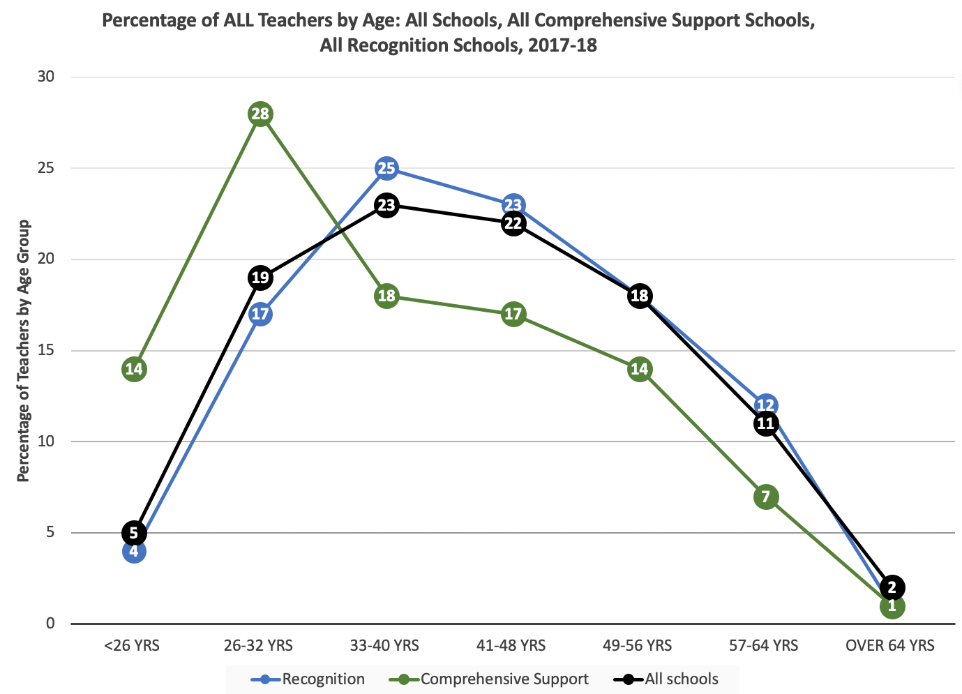
Teacher Experience. In the four chronically underperforming schools, the staff is dominated by younger, less experienced educators. Statewide the range of teacher ages falls on a bell curve with about 10 percent either at the earliest or latest stages of their career. In chronically underperforming schools, however, over seventy-five (75) percent are under thirty-two (32) – compared with twenty-two (22) percent statewide. ²
Annually, the DOE reports the age distribution of teachers. Age is a placeholder for experience.
In this chart, the black line represents the statewide distribution of teachers by age, which is close to a bell curve with lower percentages of teachers under 26 or over 64 years of age and highest between 33 and 48,
At the 53 Recognition Schools (blue line), this distribution mirrors statewide figures with slightly higher percentages of teachers between 33 and 48.
In contrast, the 30 Schools in Need of Comprehensive Support (green line) have significantly higher percentages of young teachers: 42 percent are below 33.

Slide 16
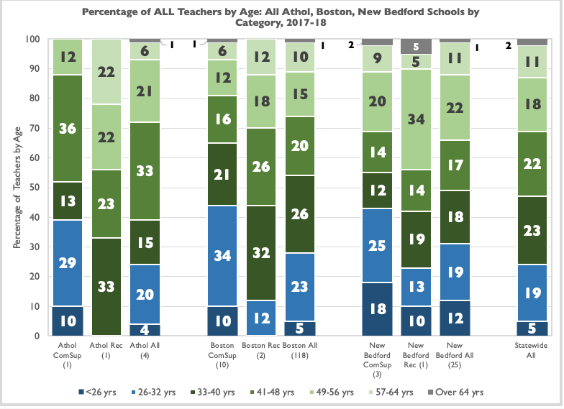
Teacher Experience in Schools in Need of Targeted Assistance and Recognition Schools. Three districts have Schools in Need of Comprehensive Support and Recognition Schools: Boston, Athol, and New Bedford.
The distribution of all teachers by age in Athol is similar to that of the state, Boston has four percent more teachers and New Bedford has seven percent more teachers below 33 than the statewide average.
Athol. Thirty-nine (39( percent of teachers in Comprehensive Support Schools (CSS) are below 33, all teachers in Recognition Schools (RS) are older than 32.
Boston. Forty-four (44) percent of teachers in CSS are below 33, eighty-eight (88) percent in RS are 33 or above.
New Bedford. Forty-three (43) percent of teachers in CSS are below 33, seventy-seven (77) percent in RS are 33 or older.
In this chart, blue represents younger teachers: <26 and 26-32 years old, green represents teachers 33-64, and grey above 64. For each district, column 1 are comprehensive support (ComSup) schools, middle column are recognition (Rec) schools, and third column are all schools. Statewide figures are in the last column on the far right.

Slide 17
School Assessment Legislative Recommendation. School assessment primarily based on multiple indicators using actual student school work and engagement, adherence to community school principles, connections to MassCore, and statewide testing on either a census or sample basis or a combination of both.
  Assess learning outcomes through actual student work.
  Report cards and grade distribution across grades and subjects.
  Progress on curriculum standards leading to successful completion of MassCore by grade 12.
  Demonstration of student work and learning, including portfolios, capstone projects, performances, real-world applications.
  Student engagement, including attendance, promotion and graduation rates, service and community-based activities
Replace Current Census Testing with Selected Sample Testing in Grades 3, 5, 6 and 7.
Census Testing. Every student in grades 3-8 and 10 takes the same test for a particular grade and subject. Time consuming practice that leads to teaching-to-the-test and a narrowing of the curriculum.
Selected Sample Testing. All students take a sample of test items. The sample can be used to generate group and school level scores. Results in less time on testing and undercuts teaching to the test activities.
  Analyze school conditions related to learning.
  Time on learning, including before and after school and vacation learning activities.
  Family engagement, including parent/caregiver contributions to school decision-making and school climate activities.
  Community engagement, including contributions of funding and time by local businesses and social organizations
Establish Two MCAS Performance Categories.
Revise school assessment metrics as a means of identifying schools needing assistance.
Eliminate set percentages for “failing” schools. Identify only those schools that are in true need.
Needing Assistance Schools for those whose school assessment metrics indicate that additional support, guided through local control, is required.
Not Needing Assistance Schools for all others.

Slide 18
Funding Legislative Recommendation. Funding for all schools, with additional focused funding to schools with high-need populations or schools identified as needing assistance. Funding decisions made at the school/district level must be determined by school committees and communities with minimal input from DESE.
Address the fact that state funding for education has not kept pace with needs either adequately or equitably. As a result, Massachusetts is among the states with the most unequal funding for local schools.
The funding gap between high and low wealth districts is significant: in FY17 Springfield spent 100 percent of its foundation requirement while Dover spent 239 percent.
Low wealth districts must have funding to bridge the gap with high wealth districts where families have the ability and practice of investing social capital in their children outside the school system.
  Increase funding to all schools, with additional focused funding to schools with high need populations.
  Fund social and emotional well-being programs embedded within community schools model.
  Craft legislative language that assurers funding decisions made at the school/district level with minimal input from DESE.
  Articulate funding decision guidance
  Align funding with student need based on socio-economic status (SES), language status, disability, and poverty.
  Bridge the gap between high and low wealth districts .
  Fund community schools in high need areas.

Slide 19
External Receivers for Underperforming Schools. According to the DESE report Turnaround Practices in Action, over $50.26M of combined School Redesign Grants and Bridge grant funding was awarded to 31 Level 4/underperforming schools between 2010 and 2014. Of that amount, $8.9M (18 percent) went to consultants. According to the DESE, half of these schools showed achievement gains and half did not. ³ Between 2003 and 2015, DESE spent approximately $13.5M in Holyoke alone in targeted assistance funds and mandatory, with little change in student outcomes. ⁴
Not sure data in this table is useful. We should talk.
External Receiver | District, Schools | Years Operational | Current Status
Blueprint Schools | Boston, Dever School | 2014-15; 2015-16; 2016-17 | Contract non-renewed
Collaborative for Educational Services | Holyoke, Dean VT School | 2012-13; 2013-14 | Contract terminated
EdLabs | Springfield, 6 schools | 2013-14 | Left after 1 year of 3-year contract
Empower Schools | Lawrence, Salem, Springfield, advisory capacity |  | Currently supports Springfield Empowerment Zone
Project Grad | Holyoke, Dean VT School | 2013-14; 2014-15 | Contract non-renewed
 | Holyoke, Morgan School | 2014-15 | Contract terminated
UP Education Network | Lawrence, 2 schools Springfield, 1 school |  | Contracts active

Slide 20
References
  See MassInc’s report Local Accountability: An Untapped Strategy for Advancing Student Achievement in Massachusetts Public Schools, page 8. “Under federal accountability laws, the state is required to rank all schools using a one-size-fits-all formula that does not accurately distill the performance of inclusive urban schools. The results is persistent communications by public education agencies that weakens already fragile real estate markets in Gateway Cities. This has significant fiscal consequences because these communities depend heavily on residential property to generate revenue, especially in comparison to major cities, which can draw on large commercial tax bases. With less revenue to fund public schools and maintain neighborhoods, state and federal accountability formulas that undermine urban communities can create a self-fulfilling prophecy.”
  ² Targeted Assistance Schools: Athol Community Elementary School; Boston – Brighton High, Dearborn, Dorchester Academy, Excel High, Henry Grew, Madison Park High, Dever, English High, Up Academy Holland, William Ellery Channing; Fall River – Fonesca Elementary, Samuel Watson; Holyoke – Morgan, Dean VT High; Lawrence – Oliver, Up Academy Oliver Middle; New Bedford – Hayden/McFadden, Avery Parker, New Bedford High; Springfield – Chestnut Academy, Forest Park Middle, High School of Commerce, Impact Prep, Kennedy Middle, Duggan Middle, Kiley Middle, Rise Academy, High School of Science & Technology, Van Sickle Academy. Recognition Schools: Andover – West; Athol-Royalston - Royalston Community; Attleboro – Hyman; Belmont – Butler; Berkshire Hills -Muddy Brook; Billerica – Dutile; Boston – Manning, Winship; Bridgewater-Raynahm – Laliberte; Concord – Willard; Dover – Chickering; Franklin – Kennedy7; Groton-Dunstable – Roche, Swallow/Union; Hingham – Plymouth River, South; Hopkinton High; Lenox High; Lexington – Harrington, High School; Medfield High; Natick – Bennett-Hemenway; New Bedford – Congdon; Newton – Horace Mann; North Reading – Little, Batchelder; Norwood – Prescott; Plymouth – Cold Spring; Rockland – Jefferson; Scituate – Cushing; Sherborn – Pine Hill; Shrewsbury – Spring Street; Shutesbury Elementary; Somerset – South; Somerville – Brown; Sudbury – Haynes; Wakefield – Walton; Waltham – Stanley; Wayland - Loker; Wellesley – Hardy, Bates; Westhampton Elementary; Westwood – Downey, Jones; Williamsburg – Dunphy; Winchester – Ambrose, Vinson-Owen, High School; Worcester – McGrath, Wawecus; Community Day Kingman Charter; Pioneer Charter of Science II.
  ³ See DESE’s Turnaround Practices in Action (July 2014). Available at www.doe.mass.edu/turnaround/practices-report-2014.docx
  ⁴ Styles, H. (2015). Course correction: Can Holyoke fix its underperforming schools before the state takes over. Valley Advocate, April 14, 2015. Retrieved on April 1, 2019 at https://valleyadvocate.com/2015/04/14/course-correction/

Slide 21
Sources
  ASCD (Undated). Whole child tenets. Alexandria, VA: Association for Supervision and Curriculum Development. Retrieved on February 27, 2019 at http://www.ascd.org/whole-child.aspx
  Balfanz, R. and Byrnes, V. (2019). College, career, and life readiness: A look at high school indicators of post-secondary outcomes in Boston. The Boston Foundation. Retrieved on March 3, 2019 at https://www.tbf.org/-/media/tbf/reports-and-covers/2019/boa_readiness-report-201903-v2.pdf?la=en
  Forman, B., DePascale, C. and Domaleski, C. (2018). Local accountability: An untapped strategy for advancing student achievement in Massachusetts public schools. Boston: MassInc. Retrieved on February 15, 2019 at https://2gaiae1lifzt2tsfgr2vil6c-wpengine.netdna-ssl.com/wp-content/uploads/2019/02/Local-Acountability-Policy-Reports.pdf
  Jehlen P. D. (2018). Rethinking school accountability: Opportunities for Massachusetts under the Every Student Succeeds Act. Boston: Commonwealth of Massachusetts. Retrieved online on June 15, 2018 at https://malegislature.gov/Bills/190/S2528
  Jones, C., Berger, N., and Hatch, R. (2018). Building an education system that works for everyone: Funding reforms to help all our children. Boston: Massachusetts Budget and Policy Center. Retrieved on March 1, 2019 at http://www.massbudget.org/report_window.php?loc=Building-an-Education-System-that-Works-for-Everyone.html
  Massachusetts Department of Elementary and Secondary Education. (2018). College and career readiness: MassCore. Retrieved on March 3, 2019 at http://www.doe.mass.edu/ccr/masscore/
  (2019). Current Frameworks. Retrieved on March 10, 2019 at http://www.doe.mass.edu/frameworks/current.html
  (2019). Archived Frameworks. Retrieved on March 10, 2019 at http://www.doe.mass.edu/frameworks/archive.html
  (2019). 2017-18 Educators by age groups report (school) for teacher by full-time equivalent. Retrieved on March 18, 2019 at http://profiles.doe.mass.edu/state_report/agestaffing.aspx
  Rocheleau, M. & Vaznis, J. (2018). Here are the school districts that scored the best – and worst – on MCAS. The Boston Globe, October 2, 2018. Retrieved on March 18, 2019 at https://www.bostonglobe.com/metro/2018/10/02/here-are-school-districts-that-scored-best-and-worst-mcas/3GHWlcdHdK7A6knLmskvXI/story.html

Slide 22
Sources
  Skinner, K.J. (2017). The six pillars of community schools toolkit: NEA resource for educators, families & communities. Washington: National Education Association. Retrieved on January 14, 2019 at http://www.nea.org/assets/docs/Comm%20Schools%20ToolKit-final%20digi-web-72617.pdf
  U.S. Department of Education. (2018). Full service community schools program. Washington: United States Department of Education. Retrieved on February 13, 2019 at https://ed.gov/programs/communityschools/index.html
  (2014). Massachusetts districts adopt rigorous MassCore course requirements for high school graduates. Washington: United States Department of Education. Retrieved March 29, 2019 at https://sites.ed.gov/progress/2014/01/massachusetts-districts-adopt-rigorous-masscore-course-requirements-for-high-school-graduates/

Slide 23
About this Series
The Massachusetts Association of School Committees’ series of three reports provides guidance and recommendations for public discourse on the use of district, state, and federal resources to support the education of our students from pre-kindergarten through grade 12.
Part 1: School Accountability: Understanding State and Federal Rules
Describes the current accountability process required by state law and federal regulations, the method for identifying the lowest performing schools, and the number and type of school by districts Levels 1 through 5.
Part 2: Challenges to Opportunities: Applying Lessons Learned from School Accountability
Addresses the proposed changes to state accountability methods resulting from changes in federal requirements, critiques past state sanctions and assistance, and proposes methods grounded in collaboration and focused on the needs of all students.
Part 3: Making a Difference: School Accountability Focused on Children & Their Families
Outlines the need for equitable schooling focused on the academic and developmental needs, and social-emotional well-being of the whole child, proposes a comprehensive community schools model that supports families and engages the community in the work of the school.
Citation: Skinner, K.J. (2019). Making a Difference: School Accountability Focused on Children & Their Families. Boston: Massachusetts Association of School Committees.

