Slide 1
Career/Vocational Technical Education – Update to the Board of Elementary and Secondary Education
February 22, 2021
Notes:
Objectives
1) Inform BESE on CVTE in MA
2) Remind BESE of history of regs
3) Make BESE aware of history / implications of issue
4) Allow BESE to interact with the data and ask questions
5) Provide BESE information on field engagement and next steps
What is CVTE in MA?
Current system
How to enroll
How to select a program
Outcomes & Opportunities
Waitlist Data
Tools
Analyses

Slide 2
OBJECTIVES
1. Understand the CVTE Landscape
2. Review CVTE Admissions Regulations
3. Review Enrollment Trends
4. Present Waitlist Data
5. Provide Stakeholder Engagement
6. Update and Next Steps

Slide 3
CONTENTS
01
Career/Vocational Technical Education Background
02
CVTE Regulatory Change Background
03
CVTE Enrollment Analysis
04
Waitlist Data Collection & Analyses
05
Field Engagement & Next Steps

Slide 4
CVTE BACKGROUND
CVTE Background
01

Slide 5
1. CVTE in MA
MA has a long history of Career Vocational Technical Education programs as a part of public education.
CVTE programs prepare students for positive postsecondary transition
Funding: Perkins federal grant + state Ch. 70 funding
Governed by: MGL Ch 74 and 603 CMR 4.00 VTE Regulations
Two major shifts: Increase in the range of CTE programs and the popularity of CTE programs.

Slide 6
1. Pathways in Massachusetts
Innovation Pathways - 99 programs at 42 high schools
Early College - 23 designated programs at 35 high schools in partnership with 19 institutes of higher ed
Career Technical Initiative (3 shifts)
CTE Partnership "After Dark" - 25 programs 6 HS partnerships
Adult Technical Training programs –7 programs 23 pathways
Expansion of Ch.74 programs - over 70 programs added in last 5 years
Notes:
Verbally –
about 20% of high school students particpate in Ch.74 programs in MA.
>70 designations in last 5 years (in voc and comp schools)
and 25 After Dark second shift
And 7 adult evening programs & 23 pathways approved

Slide 7





Pathways offer
Advising
Labor Market Demand
Integrated Instruction
Work-based Learning
Credential Preparation
Postsecondary Linkages
ADVISING
LABOR MARKET DEMAND
INTEGRATED INSTRUCTION
WORK BASED LEARNING
CREDENTIAL PREPARATION
POST SECONDARY LINKAGES

Slide 8
1. Why Career Vocational Technical Education?
Students in CVTE benefit from
Choice in their programs of studies
Strengthened academics with academic/technical integration
Engagement in "Deeper Learning"
Belonging to a community of learners
Opportunity of expanded options
Notes:
Academic and Technical Education
“Deep Learning”1
Mastery – Develop knowledge and skill
Identity – Find connections to what one is learning and doing
Creativity – Produce something, not just passively receive knowledge
Sense of belonging for students
Options and Opportunities
Ability to Select Technical Program
Work-Based Learning / Paid Co-Op
State of the Art Equipment and Technology
State and National Competitions (DECA, FFA, SkillsUSA)

Slide 9
1. Overview Chapter 74 Programs in Massachusetts
Chapter 74 programs are offered in 90 districts
26 standalone regional vocational-technical districts
58 local/academic regional districts (including 5 municipal vocational schools)
2 charter districts
2 county agricultural schools
1 independent vocational and agricultural school
1 educational collaborative

Slide 10
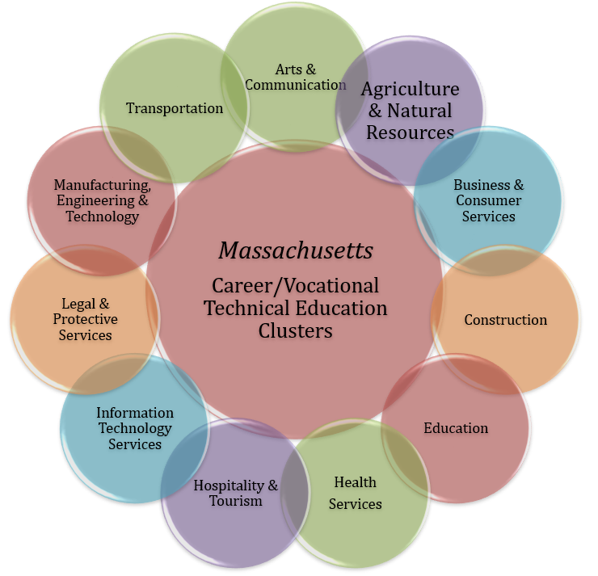
1. Chapter 74 Programs in Massachusetts
44 programs in 11 clusters
Tied to Business and Industry Demands

Slide 11
1. Chapter 74 Frameworks – The Foundation
Overview of Frameworks
Strand 1: Safety and Health Knowledge and Skills
Strand 2: Technical Knowledge and Skills
Strand 3: Embedded Academic Knowledge and Skills
Strand 4: Employability and Career Readiness Knowledge and Skills
Strand 5: Management and Entrepreneurship Knowledge and Skills
Strand 6: Technological Knowledge and Skills
Framework Development
Subject-Matter Experts
Regional Blueprints
Advisory Boards
EOWLD

Slide 12
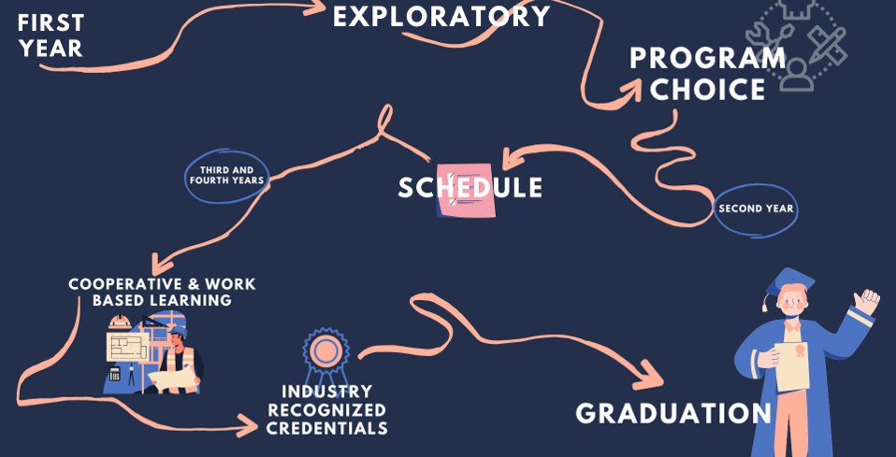
1. CVTE Student Experience

Slide 13
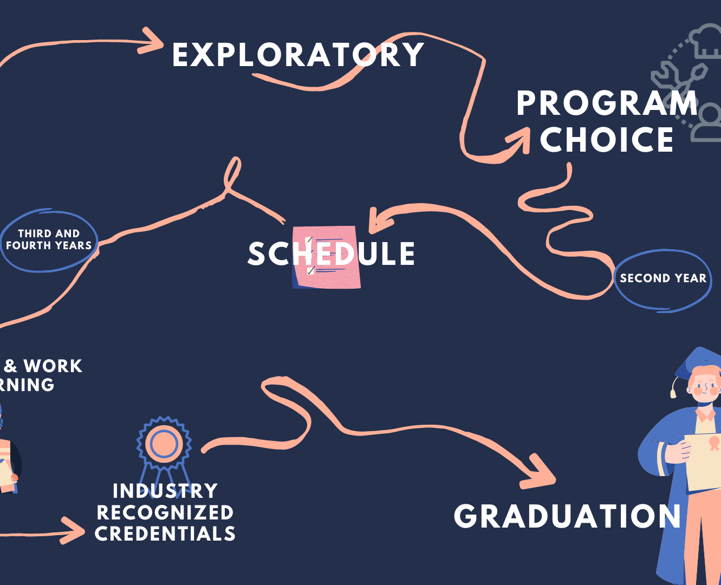

Our ninth grade student
Our 9th grade student...
Explores programs
Chooses Electricity
Follows academic/technical schedule
Engages in cooperative education
Participates in community-service learning
Graduates with both career/college options
Notes:
Exploratory – An opportunity to discern interests
Program Selection – Determining a path forward
Scheduling – Typically alternating weeks in academic courses and technical areas
Credentialing – Students earn industry recognized credentials within their technical area of study
Work-Based Learning – Opportunities to engage in offsite workplaces, both as class experiences and in paid internships

Slide 14
CVTE Admissions Regulations
CVTE Admissions Regulations
02

Slide 15
2. CVTE Defined
Two types of vocational programs in Massachusetts
"Chapter 74" programs
Receive state and federal funding
Must comply with federal and state vocational laws
Including DESE's regulations at 603 CMR 4.00
These programs are the focus of DESE's waitlist analysis
"Perkins" programs
Receive only federal funds
Outside the scope of state vocational laws

Slide 16
2. Statutory Language
M.G.L. c. 74 sec. 1:
The following words, as used in this chapter, shall have the following meanings unless the context otherwise requires:
“Commissioner”, the commissioner of education.
“Approved”, the approval of specific vocational-technical programs by the commissioner of education, acting through the division of occupational education, following investigation and determining the appropriateness of programs as to organization, control, location, equipment, courses of study, qualifications of teachers, methods of instruction, conditions of admissions of student, employment of students and expenditures.

Slide 17
2. Current Admission Regulations
Chapter 74 vocational programs must comply with DESE's admissions regulations:
603 CMR 4.03: Program Approval Criteria and Operational Requirements
Each school district requesting full approval of a vocational technical education program shall demonstrate that the program meets the following approval criteria:
(6) Admission of Students.
(a) Each vocational technical school and comprehensive school which is selective in terms of admission to its secondary vocational technical programs shall develop and implement an admission policy that is consistent with the Department's “Guidelines for Admission Policies of Vocational Technical Secondary Schools and Comprehensive Secondary Schools” that are incorporated into 603 CMR 4.00 by reference. The policy must be approved by the Department prior to implementation. The policy shall be published in the Program of Studies and a copy shall be provided to each student applicant and their parent/guardian. The policy must include the following:
1. The criteria to be used in selecting students and the process for application and admission to the school. Each selective vocational technical secondary school in Massachusetts shall use a combination of selection criteria to determine which applicants have an ability to benefit, and therefore be admitted to the school unless the school opts to use first come-first served or a lottery for admissions. The criteria used shall include academic grades, attendance record, discipline/conduct record, recommendations from the sending-school counselor and may include a student interview, provided however, that no one criterion exceeds 50% of the total. Resident students who meet the minimum requirements for admission shall be admitted prior to acceptance of any nonresident students seeking the same course of study. Schools shall condition admission on a student having been promoted to the grade that they have been admitted to enter. Schools may condition admission on a student having passed courses in English Language Arts or its equivalent and mathematics for the school year immediately preceding their enrollment in a selective vocational technical school or program;
2. A description of the Exploratory Program;
3. The criteria and process to be used in selecting students for admission to particular vocational technical education programs commonly referred to as vocational technical majors within the selective vocational technical secondary school or comprehensive secondary school; and
4. A Review Process and an Appeal Process. A process at the school district level for students and parents/guardians to review and appeal the decision to deny the student admission to the school or program shall be included. The district shall maintain documentation as to the specific admission requirements that were not met, and must provide such documentation to the Department or to the student's parent/guardian upon request.

Slide 18
2. Current Admission Regulations
Each selective vocational technical secondary school in Massachusetts shall use a combination of selection criteria to determine which applicants have an ability to benefit, and therefore be admitted to the school unless the school opts to use first come-first served or a lottery for admissions.
The criteria used shall include
academic grades
attendance record
discipline/conduct record
recommendations from the sending-school counselor
and may include a student interview,
provided however, that no one criterion exceeds 50% of the total.

Slide 19
2. CVTE Admissions Regulatory Changes
Phase 1 changes adopted by BESE in February 2020, to
Support creation of new VTE programs and expand access to full range of programs for students;
Strengthen program quality; and
Streamline vocational educator licensure process and create more pathways to licensure.
Phase 2 this year: adopt necessary changes to the CVTE admissions regulations to promote equitable access to CVTE programs, effective for students starting high school in Fall 2022

Slide 20
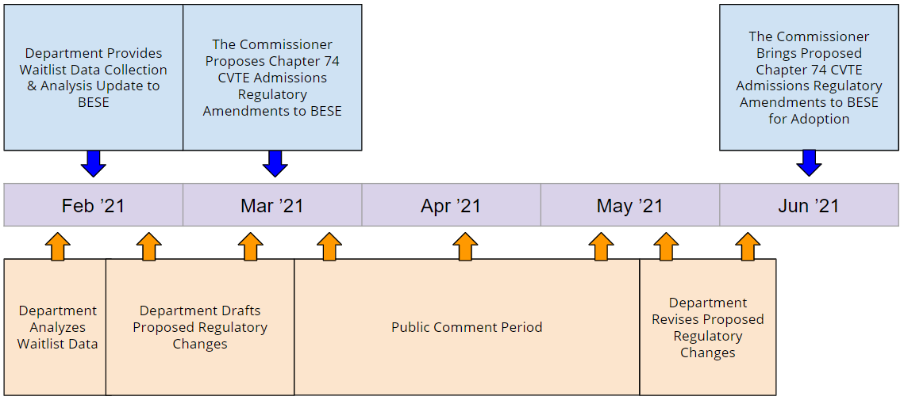
2. CVTE Admissions Regulatory Changes – Proposed Timeline

Slide 21

2. Q&A

Slide 22
CVTE Enrollment Analysis
CVTE Enrollment Analysis
03

Slide 23
3. Enrollment Analysis - Background
In 2019, DESE examined overall enrollment
statewide and at schools
for student subgroups
Compared vocational school enrollments to their catchment area (member regions) and to individual municipalities
Findings illuminated statewide trends and areas to monitor or manage
DESE identified high demand schools using gap analyses
Notes:
We'll start with Enrollment Analysis and will go to Waitlist Analysis next.

Slide 24
3. Enrollment Analysis - Findings
Previously shared with BESE:
Statewide, enrollment trends over the last few years show student populations in vocational schools and programs generally reflect the communities in their sending districts.
There is room for improvement in how vocational schools and programs – particularly in Gateway Cities - attract, admit, and retain students from their communities.
Notes:
Next few pages show statewide trends.

Slide 25
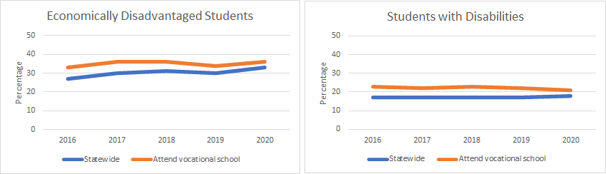
3. State Grade 9 Enrollment Trends
Year | Eco. Disadvantaged |  | Students with Disabilities
 | Statewide | Attend Voc. School | Statewide | Attend Voc. School
2016 | 27% | 33% | 17% | 23%
2017 | 30% | 36% | 17% | 22%
2018 | 31% | 36% | 17% | 23%
2019 | 30% | 34% | 17% | 22%
2020 | 33% | 36% | 18% | 21%

Slide 26

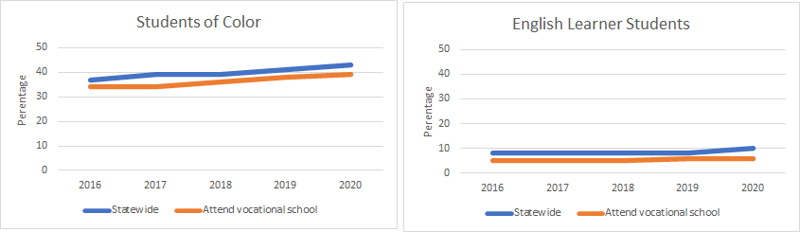
3. State Grade 9 Enrollment Trends
Year | Students of Color |  | English Learner Students
 | Statewide | Attend Voc. School | Statewide | Attend Voc. School
2016 | 37% | 34% | 8% | 5%
2017 | 39% | 34% | 8% | 5%
2018 | 39% | 36% | 8% | 5%
2019 | 41% | 38% | 8% | 6%
2020 | 43% | 39% | 10% | 6%
380

Slide 27
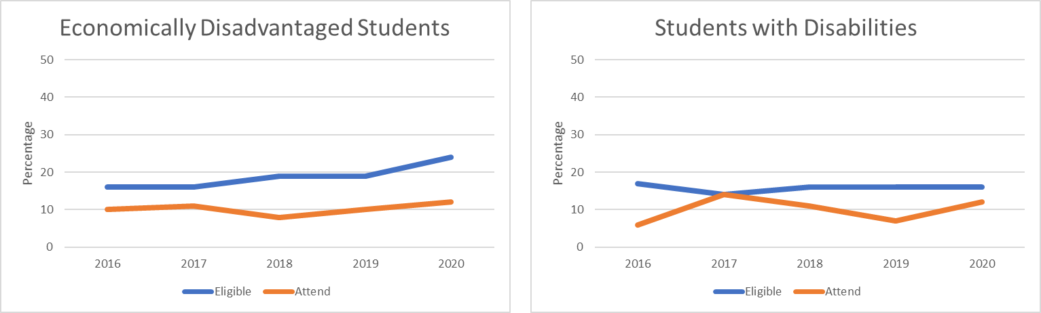
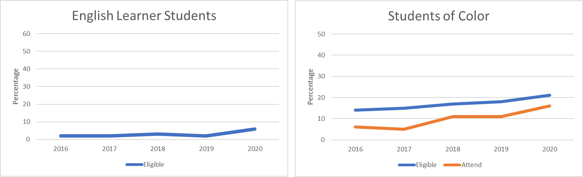
3. Example: School X Grade 9 Enrollment Trends
This is a regional school with several member towns & cities.
Looking at the members all together, the percentage of Eco. Dis. students eligible to apply to and attend the school is higher than the percentage who attend.
36

Slide 28
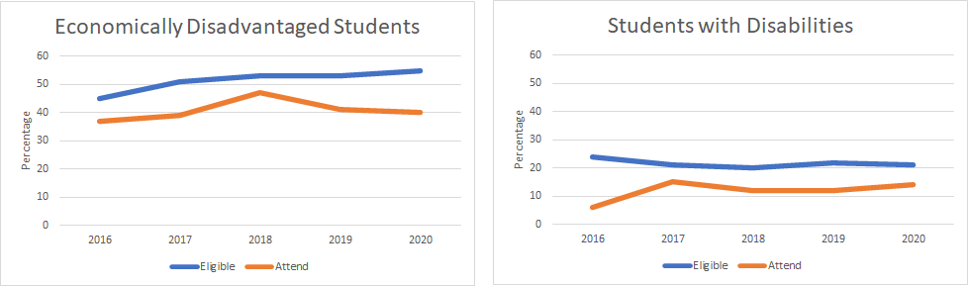
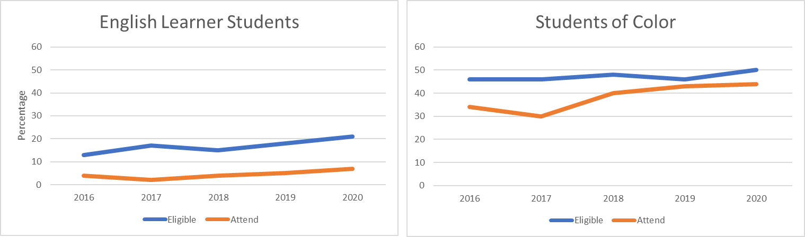
3. Example: School Y Grade 9 Enrollment Trends
This is another regional school with several member towns & cities.
Looking at the members all together, the percentage of students eligible to apply to and attend the school is higher than the percentage who attend, for several student groups.
77

Slide 29
3. Q&A

Slide 30
Waitlist Data Collection & Analyses
Waitlist Data Collection & Analyses
04

Slide 31
4. Waitlist Data Collection Process
Enrollment gap analysis prompted waitlist data collection from districts
Initially, 58 schools participated a Waitlist Survey in Summer 2020
Of these, 44 schools reported having more students submitting applications than available seats (or, a waitlist)
DESE asked the 44 to participate in Waitlist Data Collection in Fall 2020
Of these, 40 schools submitted waitlist data for Grades 9, 10, & 11
Grade 9 analysis is shown on the following slides.
4 schools had waitlist data for Grades 10 & 11 only (not for Grade 9)
Notes:
As Caitlin mentioned, part of the first round of regulatory changes.
Next few pages show highlights from the 9th grade WL collection & analysis

Slide 32
4. Waitlist Data from 2020: Analysis
Observed in several vocational schools and programs:
awareness gaps for students of color, English Learners, and students whose first language is not English
opportunity gaps for students of color, economically-disadvantaged students, students with disabilities, English Learners, and students whose first language is not English
Though study is limited (just one year’s data, affected by pandemic), it shows vocational schools and programs – particularly in Gateway Cities – can do better to attract, admit, and retain students from their communities
Awareness Gap: schools received fewer applications from students who might otherwise be expected to apply, based on their representation in sending communities
Opportunity Gap: schools admitted fewer students than might otherwise be expected from populations present in their sending communities

Slide 33
4. Waitlist Data Collection Summary
Stages
A student...
19,935 Grade 9 student records were submitted
18,560 complete applications were submitted
12,454 received an offer of admission
10,414 accepted the offer of admission
83.6% of Offers
56.1% of Completed Applications
52.2% of Records
9,951 students were enrolled as of October 1, 2020
Completes
an application
Receives an offer
Accepts the offer
Enrolls

Slide 34
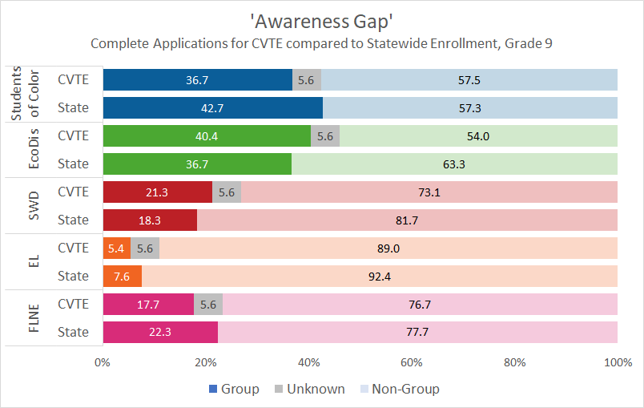
4. Waitlist: Statewide Awareness Analysis
Stages
A student...
Completes Appl.
Receives an offer
Accepts the offer
Enrolls

Slide 35
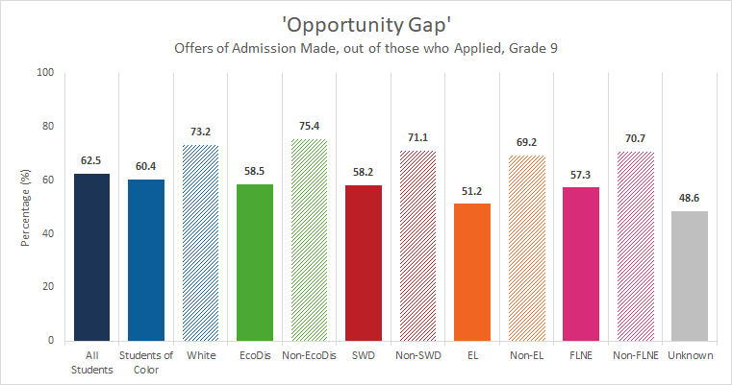
4. Waitlist: Statewide Opportunity Analysis
Stages
A student...
Completes Appl.
Receives an offer
Accepts the offer
Enrolls
35

Slide 36
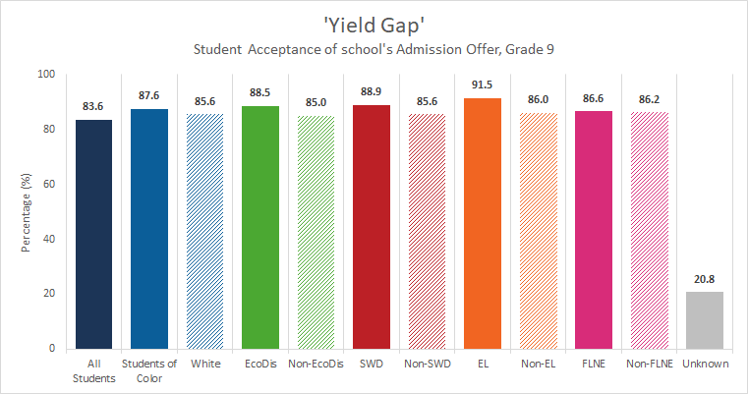
4. Waitlist: Statewide Yield Analysis
Stages
A student...
Completes Appl.
Receives an offer
Accepts the offer
Enrolls

Slide 37
4. Q&A

Slide 38
4. Admissions Stages View
These are the same one year of data as above, presented to show the stages of the admissions process.
Stages
A student...
Completes
an application
Receives an offer
Accepts the offer
Enrolls
Notes:
The next set of slides tee up the following:
Awareness gaps and opportunity gaps are varied and nuanced based on each specific context.
This speaks to the need to avoid a one-size-fits-all solution and allow for local analysis and intervention.

Slide 39
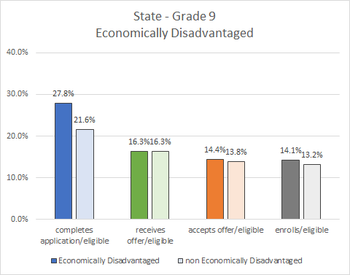
4. State Admissions Stages View
Economically disadvantaged students apply at higher rates than their counterparts...
… and go through the process at
comparable rates.​
Stages
A student...
Completes Appl.
Receives an offer
Accepts the offer
Enrolls

Slide 40
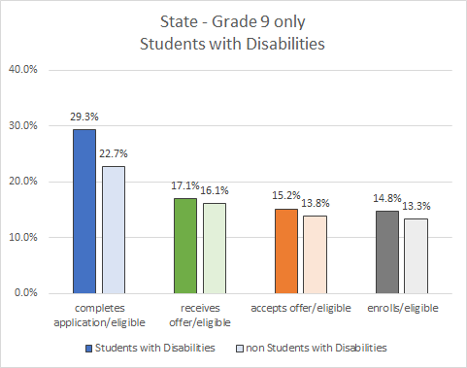
4. State Admissions Stages View
Students with disabilities also apply at higher rates than their counterparts...
… and go through the process at close-to-comparable rates.​
Stages
A student...
Completes Appl.
Receives an offer
Accepts the offer
Enrolls

Slide 41
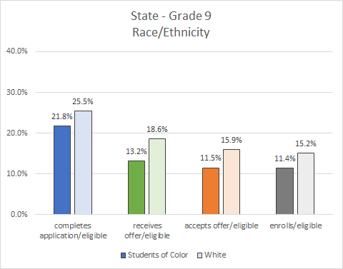
4. State Admissions Stages View
Students of color apply at lower rates than their counterparts..
… and go through the process at different rates than their counterparts.
Stages
A student...
Completes Appl.
Receives an offer
Accepts the offer
Enrolls

Slide 42
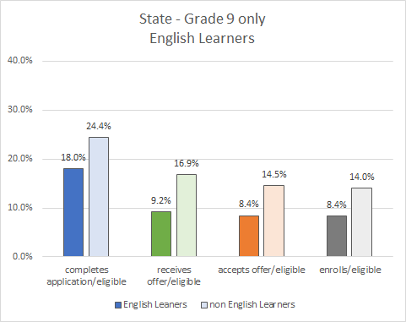
4. State Admissions Stages View
English Learner students apply at lower rates than their counterparts...
… and go through the process at different rates than their counterparts.
Stages
A student...
Completes Appl.
Receives an offer
Accepts the offer
Enrolls

Slide 43
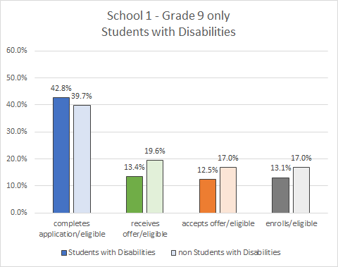
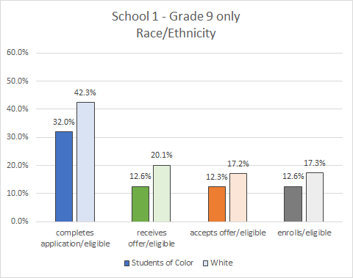
4. School X: Grade 9 Admissions Stages View
Although the percentage of students with disabilities who apply is comparable to their counterparts, there is a gap in the percentage who are offered admission.
There is a gap in percentage of students of color who apply. The gap is reduced through stages of admission.

Slide 44
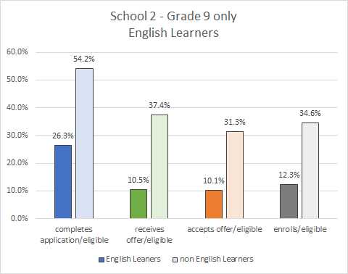
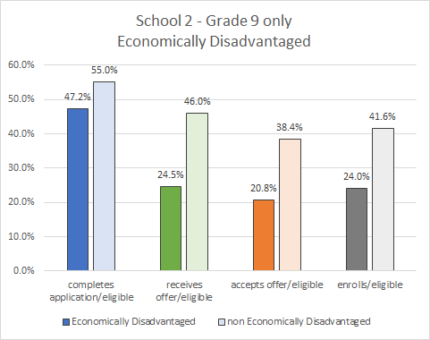
4. School Y: Grade 9 Admissions Stages View
There is a gap in the percentage of English Learner students who apply; much of it remains through stages of admission.
There is a gap in percentage of economically disadvantaged students who apply; this increases at the offer stage.

Slide 45
4. Q&A

Slide 46
Field Engagement & Next Steps
05

Slide 47
5. Field Engagement
Started conversations with high demand districts in Fall 2019
Continue to collaborate with the field
Ongoing support provided to field with technical assistance webinars

Slide 48
5. Next steps
Draft regulatory language
Develop guidance
Conduct simulations
Develop statewide supports

Slide 49
THANK YOU

