Slide 1




It’s a Balancing Act!
PRESENTED BY
VALERIE JC ANNEAR
November, 9, 2023
MASC Conference

Slide 2
WHO’S IN THE ROOM
01 | Share a little about yourselves.
02 | Share a little about myself.
03 | Agree on some group norms for our time together
Notes:
Get a sense for the group: Ask how many of you are new to your role- first 5 years? How many have served 10-20 years? More than 20? (3 mins)

Slide 3

TODAY'S AGENDA
01 | 02 | 03 | 04 | 05
Know your strengths. | Goal Setting | The 4-Dimensions of Self-Care | What’s Next? | Ticket to Leave
Notes:
Review Today’s Agenda- 1 min My goal that you’ll leave here with a draft goal you can use and commit to at least 1 self-care goal for yourself.

Slide 4
Norms
Equity of voice
Be Open
Vegas Baby
Have Fun!
Notes:
During our short time together - I want you to be comfortable with each other- this is your session. These are a few norms. We can change or add to them. Is there anything else you feel you need to get the most out of our time together? (2-3 mins)

Slide 5
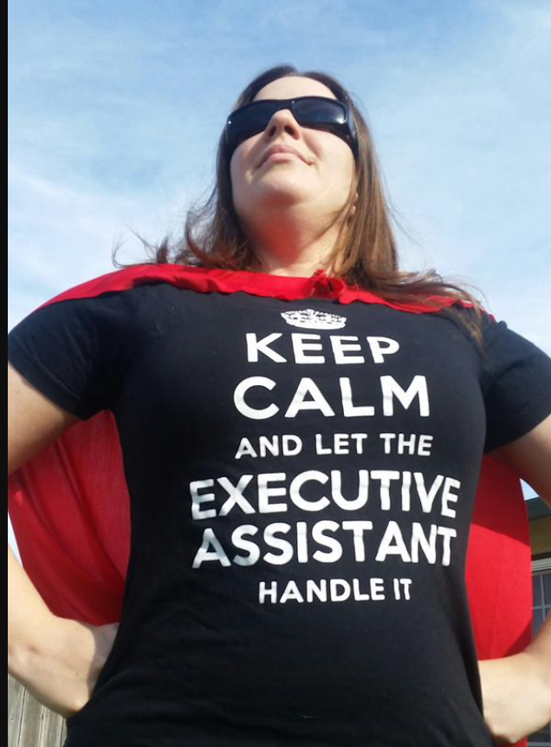
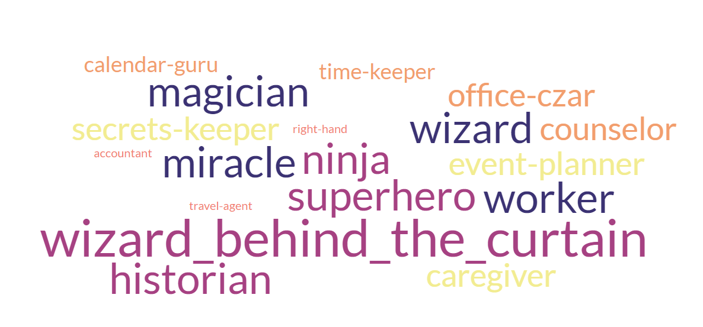
Notes:
1 mins

Slide 6


KNOW YOUR
STRENGTHS
Notes:
1 min

Slide 7

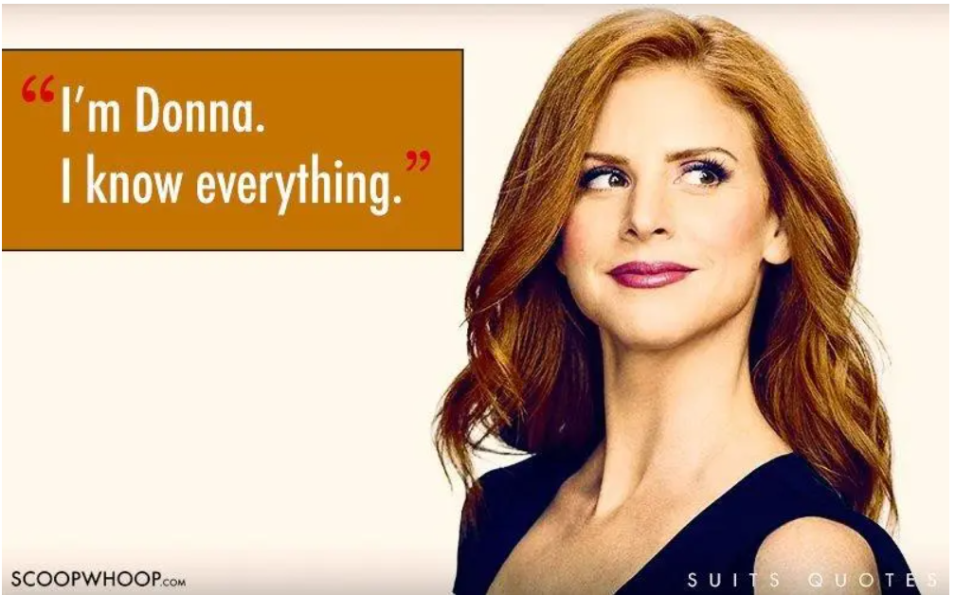
TOPS 5 SKILLS NEEDED
Notes:
Let’s say you are getting ready to retire, and you’ve been asked to select your replacement. What are the top 5 skills your replacement must be able to perform? What strengths would you be looking for? (3 mins to think and write individually. Then 5 mins to share at tables. Each table will write the strengths on the chart paper and narrow them down to the top 5) Share out. (think about one of these skills that is a strength for you). 15 mins total!

Slide 8

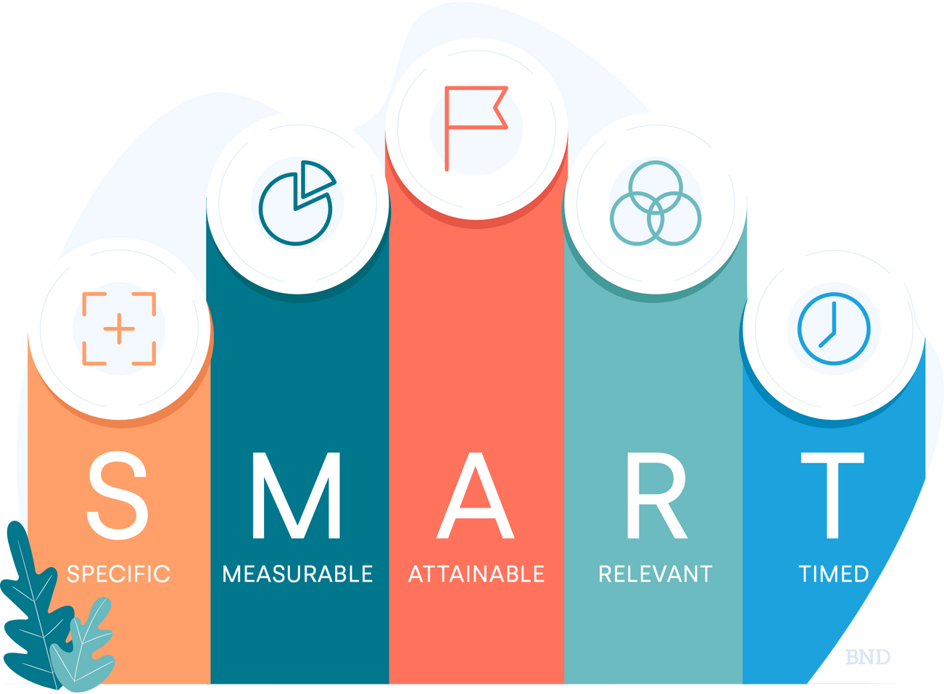
GOAL SETTING
Lead with your Strengths
Notes:
You just identified some of your strengths- now we are going to talk a little bit about your goals and how to develop goals that build upon and utilize your strengths. You’ve heard of SMART goals, right? Review SMART goals. (3mins)
I’m going to share an example and then you’ll have some time to start to think of a goal for the remainder of this year (or one for next year etc.) related to your role and that uses your strength you identified.
Let’s say my identified strengths were written communication skills and/or organization skills.
.
I’m going to share an example, and then you’ll have some time to think of a goal for the remainder of this year (or one for next year etc.) related to your role and that uses the strength you identified to help.
5 mins total

Slide 9
Increase stakeholder responses to Panaroma Survey.
Increase family/guardian responses by 15% on the Panorama Survey by:
sending monthly emails,
posting reminders 1 x month on social media
scheduling a robocall the week before and the day before the survey deadline.
Notes:
Take a look at the SMART GOAL template at your tables- let’s see if my goal is SMART. What does it need to be SMART? (3 mins).
Give them 10 mins to work on goals.

Slide 10

4 KEY DIMENSIONS OF SELF-CARE
Notes:
1 min

Slide 11


PHYSICAL
(the body)- to live, move, & breath
Eating healthy
Hydration
Exercise
Time away from computers, TV, cellphone
Enjoying moments of rest
Notes:
2 mins

Slide 12

EMOTIONAL
(Heart) to love, care, relationship w/ self and others
Set clear boundaries for your time
Have clear emotional boundaries
Surround yourself with positive people
Don’t let problems build up
Notes:
2 min

Slide 13

PSYCHOLOGICAL
(the mind)- to learn, think, & grow
Activities may include personal or professional development.
Attend to the things in your control (what’s your sphere of influence?)
Cultivate self-awareness
Notes:
2 min

Slide 14

SPIRITUAL
(the spirit) connect to your purpose, meaning, gratitude
Meditation or prayer
Practicing gratitude
Spending time in nature
Mindfulness-being present
Notes:
2 min

Slide 15

WHAT ARE YOU CURRENTLY
DOING FOR SELF-CARE?
Notes:
Think about one of the dimensions of self-care, and reflect about what you are currently doing to care for yourself in that dimension- anyone want to share out?
Anyone have a hard time coming up with something you’re doing for self-care? (perhaps this is an area for a smart goal!) 5 mins

Slide 16


What’s Next?!
Lunch & Learn
Quarterly Collaboration Sessions
Focused on...
Prioritization when everything is important!
Follow up discussions on goals
Problems of Practice: Group Problem Solving
Additional topics from the group
Notes:
1 min.

Slide 17
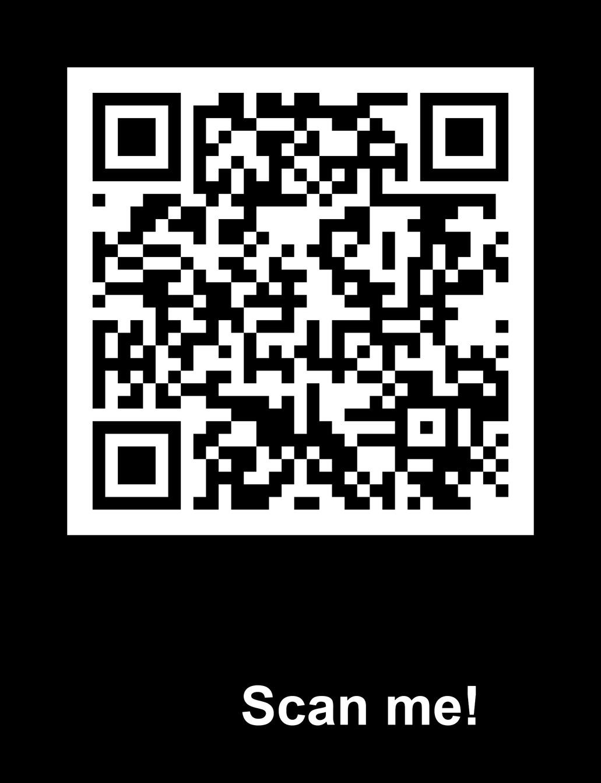
THANK YOU!
valerieannear@gmail.com
Notes:
Last 5 mins- please take a few minutes to scan the QR code and complete the feedback survey.

