Slide 1

Charting the Course
An Orientation Program for
School Leaders
OPEN MEETING LAW

Slide 2
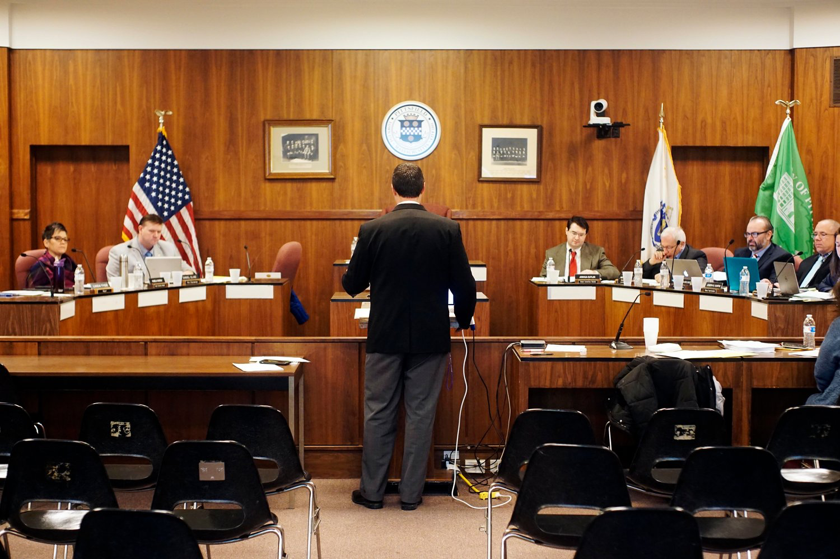
Purpose
OML provides balance between government accountability and government efficiency.
Ensures transparency by public bodies requiring:
  Advance Notice
  Open Deliberations
  Public Access
Allows government to effectively manage its operations by
  Providing for certain deliberations to
  take place in executive session
  Maintaining confidentiality of certain
  records of executive session
Pittsfield School Committee 2019
Notes:
The Purpose of The Open Meeting Law is to provide balance between the public body’s functions as a local legislature for the schools - and transparency by the public body. The public has a right to know how the public body conducts the business of governing public schools.

Slide 3


Open Meeting Law Basics
Notice must be posted, with the agenda, for all meetings
Meetings must be open to the public unless the public body enters into executive session
Minutes must be kept for open and executive session
Notes:
OML requires that
Notice of meetings is posted at least 48 hours in advance of the meeting, along with the agenda that includes a list of topics the chair reasonably anticipates will be discussed at the meeting - with sufficient specificity so that the public understands what will be discussed.
It requires that meetings are open to the public - unless the public body enters executive session for an allowable reason
It also requires that public bodies to produce accurate and timely minutes of their meetings..

Slide 4

Before the Open Meeting
Posting Requirements For School Committee
Notice must be filed with municipal clerk 48 hours prior to meeting and posted where conspicuously visible to public at all hours inside or on clerk’s office building
  Excluding Saturdays, Sundays & legal holidays
  Notice must include:
  Date, Time, Place, and Topics the Chair reasonably anticipates discussing (Agenda)
Regional District or Public Body:
  Notice must be filed and posted in each city or
  town within the district or posted via an
  alternative method (on the Regional’s website
  after proper adoption by the Regional Board)
Notes:
For Cities and Towns, meeting notices must be posted either with the City or Town Clerk and/or on the City/Town website - and that is as prescribed by the City or Town Clerk - 48 hours in advance of the meeting - exclusive of Saturdays, Sundays and Legal Holidays,
For Regional School Districts - meetings are posted with each city or town clerk within the district, or they are posted via an alternative method - such as on the Regional’s website - but only after proper adoption of that alternative method by the Regional Board. It’s always good practice to provide copies of meeting notices to the regional’s town clerks offices, even if posting on the Regional Website
Notices must always include date, time, place of the meeting and an agenda that includes topics the chair reasonably anticipates discussing

Slide 5
Open Meeting Law
M.G.L. c. 30A §§ 18-25
Definitions Under OML
Meetings & Deliberations
Meeting:
  A deliberation by a public body with respect to any matter within the body’s jurisdiction
Deliberation:
  Oral, written or electronic communications on public business between or among a quorum of a public body
    quorum: majority of members
Notes:
Definitions under OML
OML defines a meeting as: a deliberation by a public body with respect to any matter within the body’s jurisdiction. and
It defines a deliberation as any oral, written or electronic communication on the body’s public business between or among a quorum of a public body.
*THIS IS WHERE WE RECOMMEND THAT YOU EXERCISE CAUTION when having any discussion outside of a posted meeting that includes strategy or deliberation between a sub quorum of members – the reason we suggest caution is that a discussion can easily become deliberation among a quorum of the public body - FOR EXAMPLE- if one or more members who discuss a matter under the committee’s authority shares that conversation with one or more other members a serial deliberation could occur.
You might enter into a conversation - verbal or electronic - with one member of your committee that is meant to be just between two trusted colleagues, however, if that conversation is shared with other members of your body, unbeknownst to you, it becomes a serial deliberation.
For Cities and Towns, meeting notices must be posted either with the City/Town Clerk and/or on the City/Town website, as prescribed by the City/Town Clerk, 48 hours in advance of the meeting, exclusive of Saturdays, Sundays and Legal Holidays,
For Regional School DistrictS, meetings are posted with each city or town clerk within the district, or they are posted via an alternative method, such as on the Regional’s website after proper adoption by the Regional Board.
Notices must always include date, time, place of the meeting and an agenda that includes topics the chair reasonably anticipates discussing

Slide 6
Deliberation
Allowable Exclusions:
  Distribution of meeting agenda, scheduling or procedural information
  Distribution of reports or documents to be discussed, provided no opinion of a member of the public body is expressed
Notes:
There are Allowable Exclusions to deliberation rules and those are:
Distribution of meeting agenda, scheduling or procedural information and matters of housekeeping.
Distribution of reports or documents to be discussed, provided no opinion of a member of the public body is expressed
It’s important - when agenda and reports are distributed via email – to BE CAREFUL not to:
EXPRESS YOUR OPINION on any matter before the board or
REPLY ALL on matters of business before your committee.

Slide 7
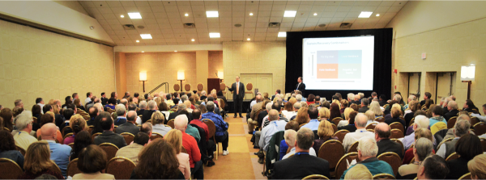
Meetings
A gathering is Not a Meeting if
The members Do Not Deliberate and the gathering is:
    An on-site inspection of a project or program;
    A public or private gathering, including a conference or training program or a media, social, or other event;
    The attendance by a quorum of the body at a meeting of another public body that complied with open meeting law by properly posting the meeting
      If the visiting members communicate only by open participation on those matters discussed by the host body;
    Town Meeting is exempt from OML
    MASC Delegate Assembly 2019
Notes:
7
A Gathering is not a MEETING if:
The members do not DELIBERATE and the gathering is:
An inspection of a program or project such as a building construction project - or a school walk-through to view school readiness for September opening, for example.
If there are questions or concerns during that on-site inspection - take notes and discuss those concerns at your next open meeting
You may attend a public or private gathering with your colleagues, including a conference or training program - or media - social or other event.
Transition to Slide 11

Slide 8

Gathering is Not a Meeting if
    The attendance by a quorum of the body at a meeting of another public body that complied with open meeting law by properly posting the meeting
      If the visiting members communicate only by open participation in the meeting on those matters discussed by the host body;
    Town Meeting is exempt from OML
Notes:
You may also attend another public meeting that has been properly posted - such as, attendance at a City Council or Board of Select Persons meeting.
You are not deliberating if the visiting members of your committee communicate only by open participation in the meeting on those matters discussed by the host body.
Do not deliberate if not properly posted. For example - there are times that a joint meeting of two legislative bodies are posted with a specific agenda.
Town meeting is excluded from the Open Meeting Law and a quorum of your body may gather there.

Slide 9

During the Open Meeting
Access & Participation - Under the Governor's Emergency Order in effect through March 31, 2025
All public bodies may meet with 100% remote participation with no local action;
All remote participants must be audible to all persons present;
All votes are by roll call;
Public must have real time access to the meeting except for reasons of economic hardship;
  Either the public is allowed to attend in person, or a remote option is available in real time
Notes:
First I’ll discuss Remote Participation (under the Governor’s Order Suspending Certain Provisions of the Open Meeting Law during the COVID-19 pandemic)
All public bodies may meet with 100% remote participation with no local action to be taken.
All participants must be audible to all persons present
All votes are by roll call
Public body must provide adequate, alternative means for real time access to the meeting by the public unless there is a particular reason of economic hardship.
Alternative means include public access through “telephone, internet or satellite enabled audio or video conference or any other technology that enables the public to clearly follow the proceedings of the public body while those activities are occurring.”
(It is not universally acceptable to show a video of the meeting after the meeting has been held as a means of providing real time public access.)
Remote Participation and Access all other times:
In cities and towns - permission by the Mayor or Select Board is required
Regional school districts can use remote participation by a majority vote of that regional school committee.
Remember – in order to participate remotely, physical presence must be unreasonably difficult,
A quorum of the body must be physically present,
The person chairing the meeting must be physically present (a chair pro-tem is allowable.)
All remote participants must be clearly audible for all persons present at the meeting.
The chair must announce the remote participation and the reason for that remote participation
All votes are by roll call
TRANSITION TO Slide 13 During the Open Meeting (Continued)

Slide 10

During the Open Meeting
Recording
Chair must inform attendees of any recordings
May not obstruct conduct of meeting
Public Comment
Requires permission of chair
Notes:
During Open Meetings - Recordings are permitted, but
The Chair must inform attendees that the meeting is being recorded and - We’d also recommend - informing attendees if the meeting is being broadcast over another medium – as a way of allowing attendees to make decisions around anonymity.
Public Comment
Requires the permission of the Chair

Slide 11

Public Participation
Public may attend open session of meeting (in-person or virtually upon the decision of the public body)
Public may not address public body without permission of chair or otherwise disrupt meeting
Public may take audio or video recording of open session upon notification to chair and subject to reasonable requirements
Chair must inform other attendees of recording at beginning of meeting
Notes:
Members of the public may attend open session meetings of the public body but
They may not address the public body without permission and may not disrupt the meeting.
If members of the public are disruptive, they can be asked to remain silent or be removed from the meeting if they do not comply – use caution here and do not suppress comment on matters under the body’s jurisdiction. Keep comments away from identifying individuals who have rights to privacy, such as students.
Note that in most cases it can be less disruptive for members of the body to listen without responding if
the comments are not disruptive,
are on matters under the body’s purview, and
within the allotted time period for a public comment period that is listed on the agenda.
If your agenda does not list public comment – it is solely at the discretion of the chair.
OML allows recording of public meetings, except executive sessions, only after notifying the chair of the public body, and as long as the recording does not interfere with the conduct of the meeting.
Chair must inform other attendees … because Massachusetts is known as a two-part consent state because – Massachusetts bans “secret” recordings rather than requiring explicit consent from all parties. MGL C.272, S.99

Slide 12

Minutes & Public Records
Minutes (Open and Executive Session) must include:
Date, time and place of meeting
The members present or absent – annotated as to arrival and departure times, if while meeting is in progress
A summary of discussion on each topic
List of all documents and exhibits used at meeting
Record of all votes, decisions made, and actions taken
Minutes must be made available upon request
  Within 10 days of request
  In draft or approved form (Open Session)
Approval of Minutes
  Meeting minutes must be created and approved in a timely manner (within the next 3 meetings or within 30 days, whichever is latest)
Notes:
Minutes must be produced for all public body meetings
They must include the date, time and place of the meeting
Note members present and absent,
List the names of any members who participated remotely
Include notation as to late arrival or early departure of any public body members while the meeting is in progress.
Minutes must contain a summary of discussion of each topic - this is a general summary so that someone who didn’t attend the meeting could have an understanding of the discussion - this is not a verbatim or he said/she said summary.
include a list of all documents and exhibits used at the meeting.
full copies of those documents need not be part of the minutes, but they are part of the record and must be kept for public access according to Municipal Records Retention Schedule. link record retentions schedule in workbook.
All votes must be recorded as to decisions made and actions taken.
Minutes must be made available upon request within 10 days, and can be provided in either draft or approved form. Executive session minutes do not have to be provided until reviewed and released by the public body and can be released in redacted form.
OML tells us that Minutes must be created and approved within 3 meetings or 30 days, whichever is latest.
***Transition to Slide 14

Slide 13
Minutes & Public Records
Executive Session Minutes
Require the same content as open session minutes
May be withheld only until release no longer defeats the purpose of the executive session
  Minutes may be withheld in their entirety or released in redacted form
  Release of executive session minutes must be announced at open meeting.
Upon request for release, must respond within 10 days of request
Notes:
Executive Session Minutes
require same content as open session minutes
they may be withheld from release until the purpose for keeping them confidential no longer defeats the purpose of the executive session
Exectuve Session minutes may be withheld in full or may be released in redacted form
Release of executive session minutes must be announced at an open meeting, i.e., on the agenda for release.
If Executive Session minutes that have not yet been released are requested, the public body must respond within 10 days and
Minutes are released if they have been reviewed and if they are no longer exempt, or
If they are reviewed at the next Executive Session meeting or in 30 days, whichever is shorter.

Slide 14

Definition of Personnel Information
  Materials used in a performance evaluation, related to an individual’s professional competence if created by members of the public body are releasable public records.
  The public will have access to any evaluations created by members of the public body
  The compilation document must be made available to the public as soon as it is shared with the school committee.
  Employee personnel files are typically
  not considered to be public records.
Notes:
Personnel materials are used in hiring, evaluation, and in executive session.
Most personnel materials are not public record:
During the hiring process, only resumes are part of the public record, all other application materials are excluded
Evaluations created by members of the public body are public record
Compilations of evaluations by a member of the body are public record
Materials or evaluations completed by others who are not members of the public body are not public record

Slide 15

Executive Session
With remote participation the member must state at the start of the executive session that no other person is present or able to hear the discussion.
The public body may authorize, by a simple majority vote, the presence and participation of other individuals at the remote participant’s location.
Notes:
There are 10 reasons for executive session under OML
**LINK Executive Session Quick Reference to Workbook.
***Transition to Slide 19

Slide 16
Executive Session 10 Purposes:
M.G.L. c. 30A § 21(a)
§ 21(a)(1): To discuss an individual, public officer, employee or staff member’s
  Reputation
  Character
  Physical condition, or
  Mental health
  Discipline or dismissal, complaints or charges against the individual
Open Session for discussions of
  Professional competence
  At individual’s request
Notes:
Reason 1 - to discuss an individual’s reputation, character, physical condition or mental health, discipline dismissal, complaints or changes against the individual
The meeting must be held in open session if it involves a matter of
Professional competence, or
If the individual requests open session

Slide 17
Executive Session
10 Purposes: M.G.L. c. 30A §
21(a)(1)Individual’s Rights in Executive Session
  To receive written notice at least 48 hours prior to executive session
  To request that the session be open
  To be present during deliberations which involve that individual
  To speak on their own behalf
  To have counsel or representative present for purpose of advising (not for active participation)
  To create an independent record by audio recording or transcription
Notes:
The individual has rights:
to receive written notice 48 hours in advance of the meeting
to request that the meeting be held in open session
to be present during deliberations that involve that individual
to speak on their own behalf
to have counsel or representation present to advise only - not for active participation
to create an independent record by audio recording or transcription

Slide 18
Executive Session
10 Purposes: M.G.L. c. 30A §
§ 21(a)(2): To conduct strategy sessions in preparation for negotiations, with nonunion personnel
  Committee must identify the specific nonunion personnel with whom it is negotiating before entering executive session.
  When discussing the contract of nonunion personnel, the presumption is that professional competence of the individual has already been discussed in open session
Notes:
Reason 2 - To conduct strategy sessions to prepare for negotiations with non union personnel
The chair must identify the specific non union personnel prior to going into executive session
the presumption here is that professional competence has been discussed in open session
This purpose allows a public body to meet in executive session to discuss its strategy with respect to negotiating a contract with non-union personnel, and to engage in direct negotiations with nonunion personnel. However, it does not permit the public body to take a final vote to execute such a contract behind closed doors
Addl info if needed
Discussions of salary issues may only occur in executive session as part of a contract negotiation. (SeeG.L. c. 30A, § 21(a)(2), (3).
Other discussions related to salary, such as a discussion about whether an employee's job performance merits a bonus or salary increase, must be conducted in open session.

Slide 19
Executive Session
10 Purposes: M.G.L. c. 30A §
§ 21(a)(3): To discuss strategy with respect to collective bargaining or litigation if an open meeting would hurt the committee’s bargaining or litigating position and the chair so declares.
  Chair must declare that deliberating during open session would have a detrimental effect.
  Litigation must be pending or be immediately threatened
  Committee may approve final terms and execute a CBA in executive session but should disclose in open session following executive session.
Notes:
Reason 3 - To discuss strategy related to collective bargaining or litigation if an open meeting would hurt the committee’s bargaining or litigation position and the chair so declares
Topics can include discussion of proposals for wage and benefit packages or working conditions for union conditions. or
Litigation must be imminently threatened or otherwise demonstrably likely.
While CBAs can be approved in executive session, committees should disclose the terms of the settlement in open session following the executive session.

Slide 20
Executive Session
10 Purposes: M.G.L. c. 30A §
§ 21(a)(4): Security personnel or device deployment or strategy
§ 21(a)(5): Investigate charges of criminal misconduct or consider filing criminal complaints
§ 21(a)(6): Consider purchase, exchange, lease or value of real estate if the chair declares that an open meeting would hurt committee’s negotiating position
Notes:
Reason 4 - to discuss strategy related to the deployment of security personnel or devices.
Reason 5 - to investigate charges of criminal misconduct or consideration of filing criminal complaints … These are discussions that would likely precede the formal criminal complaint process in court.
This section does not require the same rights to be given to the person who is the subject of a criminal complaint under Section 1 which allows for discussions of criminal complaints that have already been brought.
Reason 6 - involves the purchase, exchange, lease value of real estate only
If the chair declares that open session would hurt the committee’s negotiating position.
Generally, the body should identify the specific piece of property being discussed, unless disclosing the location would compromise the purpose of secrecy.

Slide 21
Executive Session
10 Purposes: M.G.L. c. 30A §
§ 21(a)(7): To comply with any general law, special law, or federal grant-in-aid requirements
  Chair must cite a statute that requires confidentiality or closed session
  Body should disclose information unless public disclosure would compromise the purpose for secrecy
Notes:
Reason 7 - Is to comply with any general law, special law, or federal grant-in-aide requirements
The Chair must cite statute that requires confidentiality….
such as student record privacy and FERPA – the Federal Educaitonal Rights and Privacy Act
or to review and approve executive session minutes
you may also review and approve executive session minutes under the original purpose for the meeting.

Slide 22
Executive Session
10 Purposes: M.G.L. c. 30A §
§ 21(a)(8): To consider or interview applicants by a preliminary screening committee
    If chair declares an open meeting will have a detrimental affect in obtaining qualified applicants
    Interviews cannot be conducted in executive session if applicants have already passed an initial screening committee
  § 21(a)(9): Meet or confer with mediator
§ 21(a)(10): Discuss trade secrets or confidential, competitively-sensitive or other proprietary information
Notes:
Reason 8 - Is to consider or interview applicants by a preliminary screen committee - for school committees - during a superintendent search process.
Chair must declare that an open meeting will have a detrimental affect in obtaining qualified applicants.
Once preliminary screen interviews are held in executive session and finalists are identified, interviews must be in open session.
Reason 9 - to meet or confer with a mediator
But first, a vote to participate in mediation, disclosing the parties, issues and purpose of the mediation, must be taken in open session
Reason 10 - Allows discussion of trade secrets or confidential, competitively sensitive or other proprietary information.
Typically used by a public utilities commission
INSERT POLL – QUICK REVIEW

Slide 23

Executive Session Procedure
Review
Committee must convene an open session first
Committee must vote to enter executive session
  By roll call vote
  A majority of the full body (regardless of attendance at the meeting) must agree
  All votes are by roll call and are entered into minutes
Chair must state executive session purpose, including everything that may be revealed without compromising executive session purpose
Chair must announce whether open session will reconvene following conclusion of executive session
Notes:
READ – OVERVIEW OF SLIDE TO BOLSTER POLL RESULTS

Slide 24

OML & Social Media
Social Media such as Facebook, Twitter & Webpages
  Members may communicate with members of the public through any social media platform. However, deliberation may violate OML. Proceed with Caution.
Listserves
  Members may subscribe to a listserv. However, where a quorum of members of a public body subscribe, the public body risks unlawful deliberation. Proceed with Caution related to matters within the jurisdiction of the public body.
Notes:
Public Body members may communicate with members of the public through social media, but members may not engage in deliberation with other members of the public body via social media.
We recommend that members proceed with caution when posting about the public body’s business on social media.
Committee members may belong to a list serve that other members belong to, but where there is a quorum of the public body on that list serve, members risk unlawful deliberation.
Committee members cannot participate in discussions involving matters within the jurisdiction of the body without engaging in unlawful deliberation. We recommend that School Committee members proceed with caution.

Slide 25

OML & Electronic Messaging
Use of electronic messaging to communicate with other public body members during a meeting
With a few exceptions, any use of electronic messaging by public body members to communicate with a quorum of public body members, during or outside of a meeting, may constitute private deliberation, which is prohibited by the Open Meeting Law.
  Electronic messaging during a meeting by less than a quorum of the public body’s members, while not directly prohibited by the Open Meeting Law, is discouraged if those electronic communications are not shared at the
  meeting with the members of the
  public who are present.
Notes:
Use of electronic messaging to communicate with other committee members during or outside a meeting may constitute a private deliberation.
Please proceed with caution when messaging your colleagues of the committee during a meeting.
Best practice with electronic messages from constituents related to matters under discussion should be shared with the committee (verbally) and this is so that all members have the same information which deliberating on a matter.

Slide 26


QUESTIONS?

