Slide 1
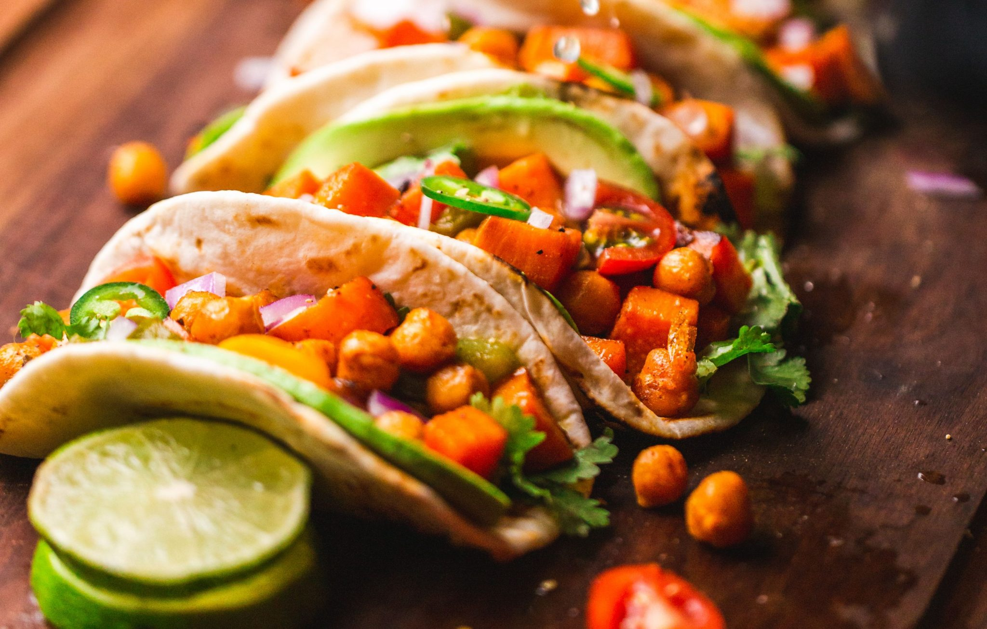
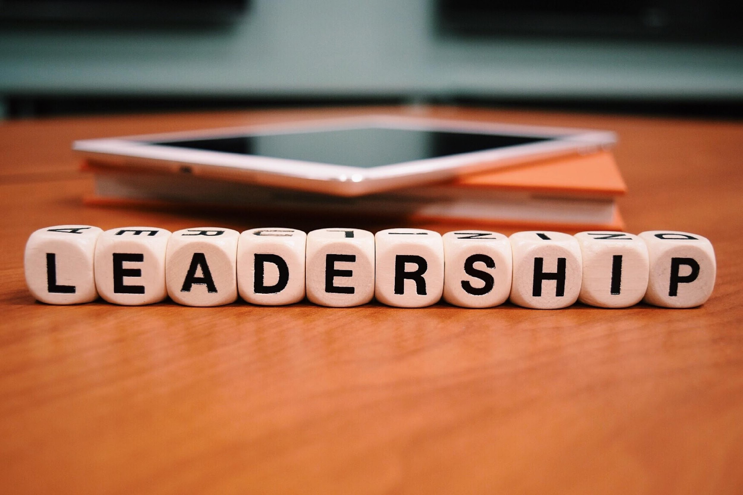
Leadership for Lunch
June 5, 2024

Slide 2

Agenda
Introductions
Purpose of Sessions
  Networking
  Confidence and Communication
  Practicing mindfulness techniques
Today’s Goal:
  Practice gratitude to support physical and mental wellness
  Communicating confidence through your choice of words and body language

Slide 3
GROUP NORMS
Start & end
on time
Accept, respect,
& learn from
our differences
Assume
Positive Intent
Be Fully Present
Allow for
equity of voices
during discussions
Notes:
attention- means screens on please. active participation- Our meeting will only as good as we all give to it.

Slide 4

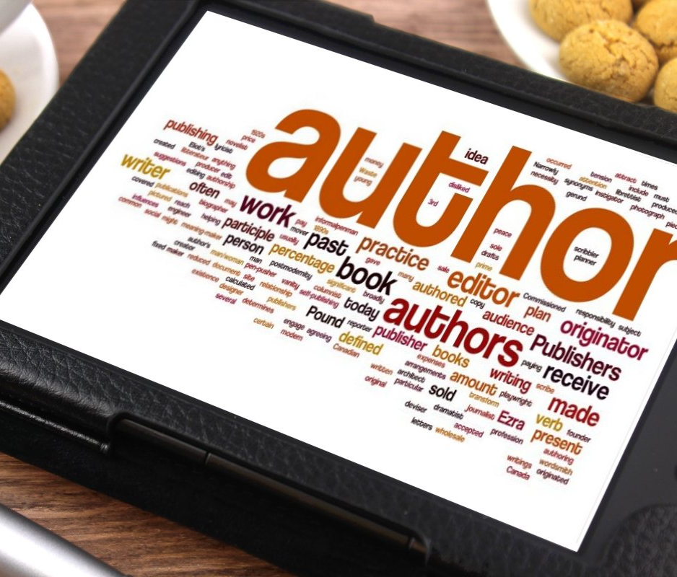
Homework
You just wrote a best seller titled, “How to be a successful Administrative Assistant Read us the first sentence.

Slide 5
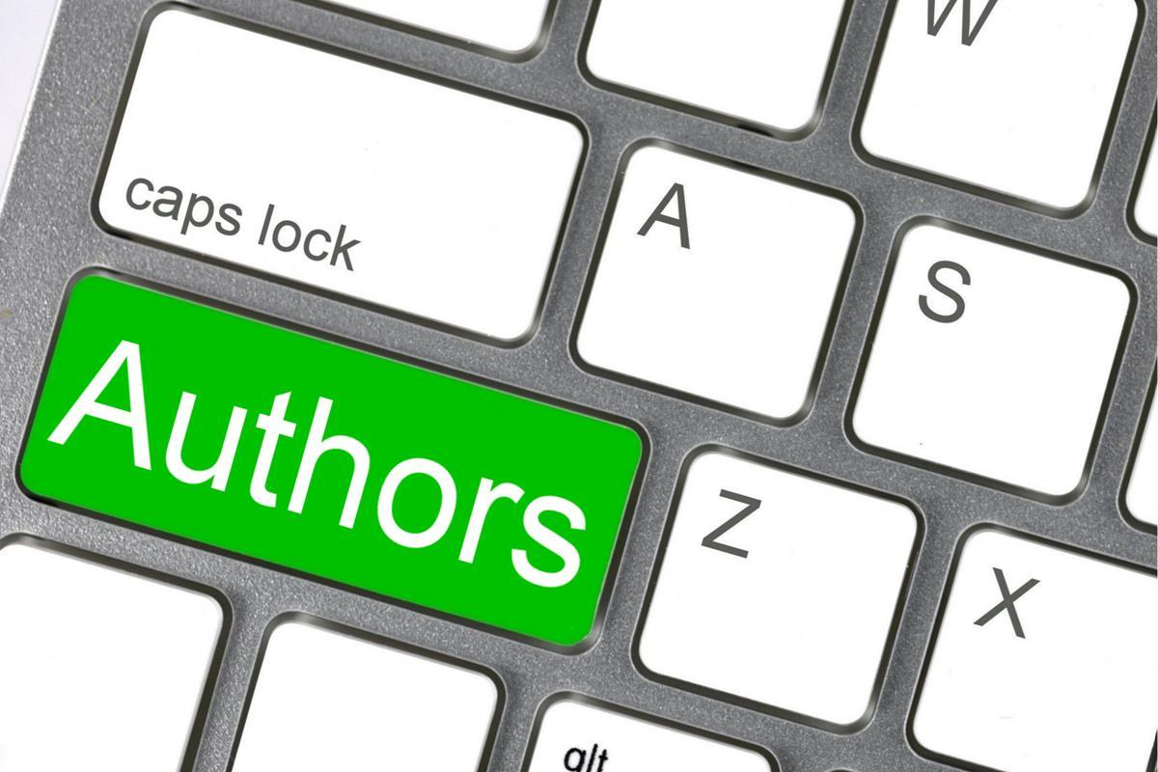
Breakout Rooms
Share your first sentence with your colleagues and discuss the book contents-
We will ask a few of your to share when we get back-
You will have five minutes-

Slide 6
Working Definition of Influence
Influence is the ability to change how someone else behaves or thinks based on persuasion instead of authority.
Unlike power, influence doesn’t allow you to directly impact someone’s actions or behavior just by telling them to do something.
Instead, you can influence others into changing the way they behave, think, or act using your personal skills. These skills include skills of persuasion and inspiration.
Relationships will also have an impact on influence. When you have a positive relationship based on trust with your peers, your actions and behaviors will be more likely to influence them.

Slide 7
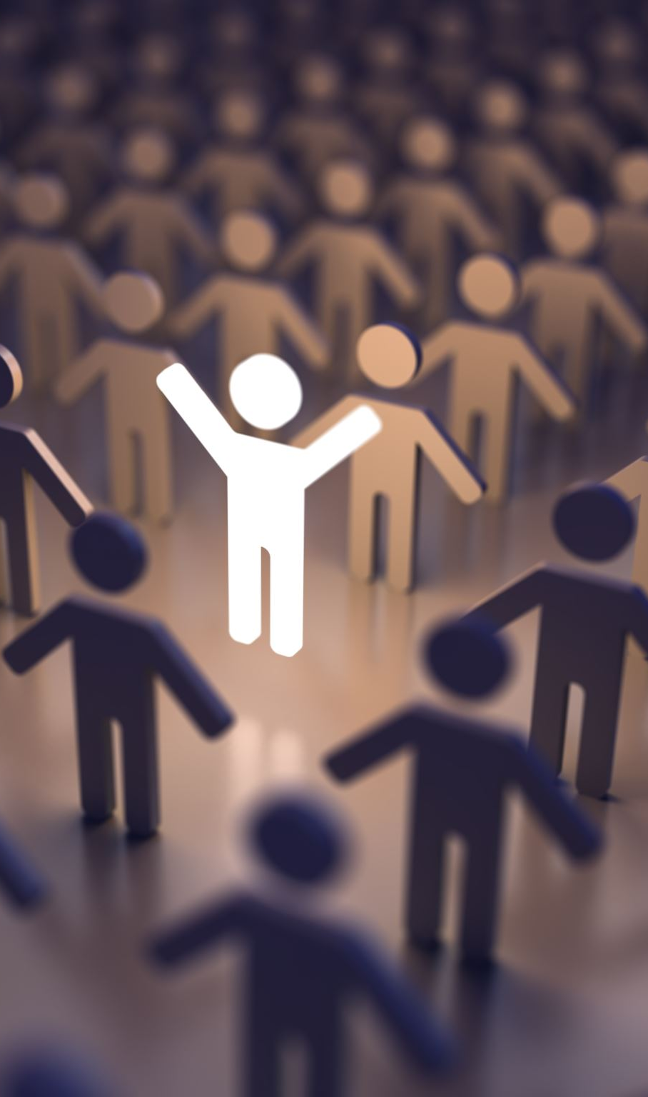
The ability to influence someone successfully is one of the most important and challenging jobs any leader will face.
5 Characteristics Every Good Leader Should Have
Decisiveness. The ability to make decisions, mainly when under pressure, is an important skill to master. ...
Trustworthiness. ...
Empowerment of others. ...
Clear communication. ...
Resilience.

Slide 8
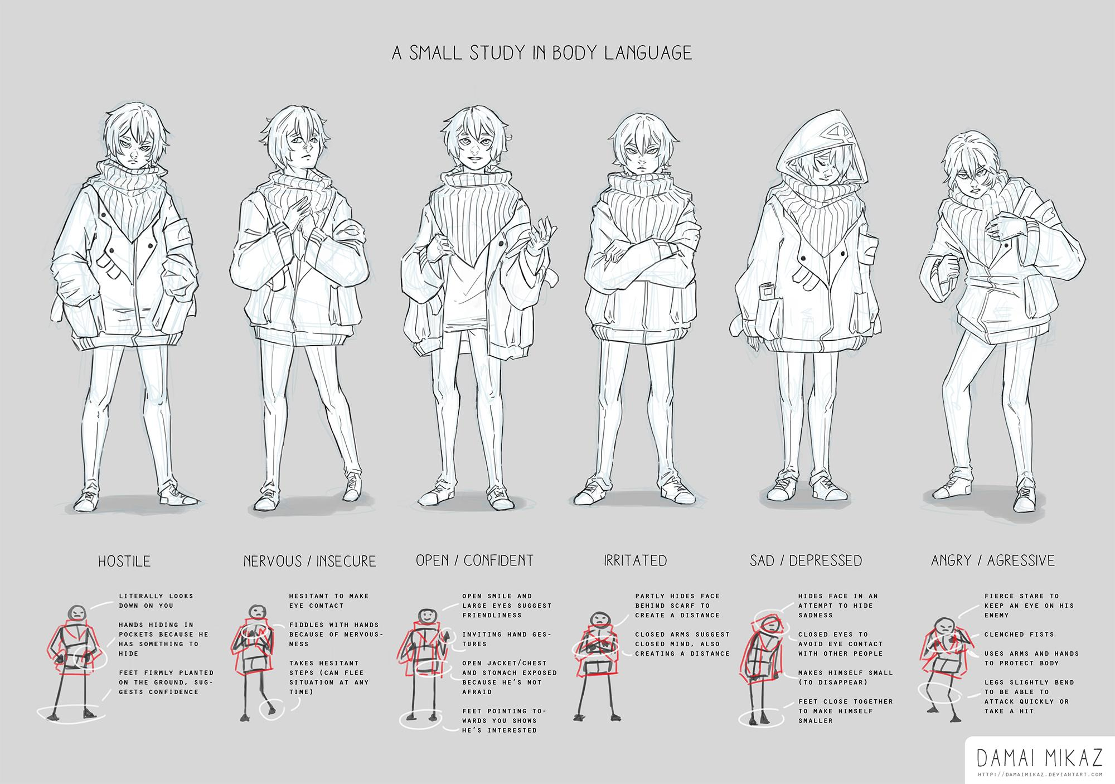
You are the Message
The most important part of the presentation is you! You become the message. The intangibles of integrity, dedication, conviction and concern are communicated 7% by our words,
38% by the way we speak, and 55% by our facial expressions and body movement. Our spoken communication, via presenting carries energy feeling, passion, and goes right to the emotional center of the brain.

Slide 9
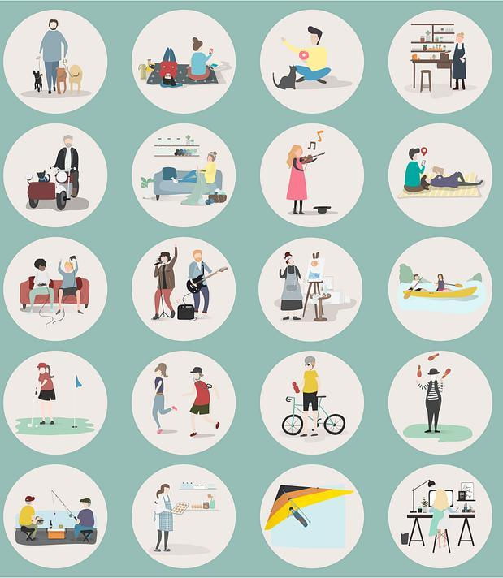
The Human Factor
The next step is to create a relationship with the group you are going to be working with….there’s got to be some kind of relationship on a personal level, not just an intellectual level. They must perceive you as a HUMAN BEING. You need to deliberately give them a sense of who you are.

Slide 10
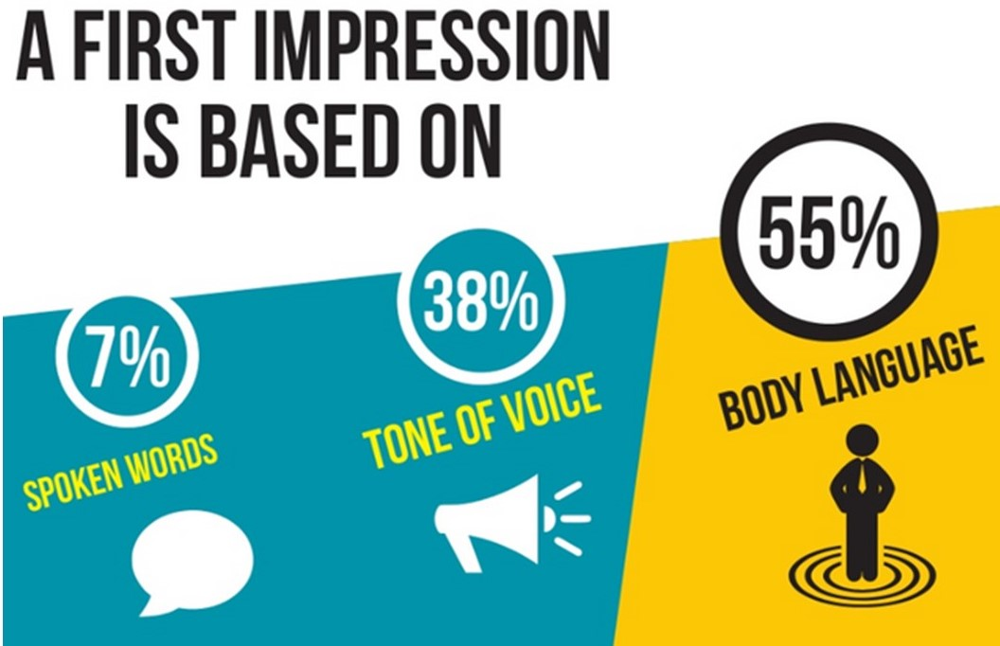
Portraying Confidence
By incorporating these body language techniques, you can effectively project confidence in various professional settings, enhancing your interactions and overall presence.
Posture
  Aim to maintain eye contact about 50-60% of the time when speaking and listening. This shows that you are engaged and trustworthy.
Eye contact
  Aim to maintain eye contact about 50-60% of the time when speaking and listening. This shows that you are engaged and trustworthy.
Gestures
  Avoid fidgeting or excessive gestures. Controlled and purposeful gestures reinforce your words and show self-assuredness.
Facial Expressions
  A genuine smile can make you appear approachable and confident. It signals positivity and self-assurance.
Voice and Tone
  Avoid speaking too quickly, as this can indicate nervousness.
This Photo by Unknown Author is licensed under CC BY

Slide 11

Make an important change in your communications
Eliminating unnecessary apologies from your conversations by eliminating the word “sorry” in your communications.
Sorry for the delay…..vs. Thank you for your patience
Sorry for the confusion….vs. Thank you for pointing that out.
Rather than apologizing for a mistake vs. I will correct that right away
Sorry to interrupt……vs. Excuse me
Sorry if this is a bad time….. vs. Is this a good time to talk?
Sorry for the inconvenience…….vs. I appreciate your understanding as we work through this.

Slide 12
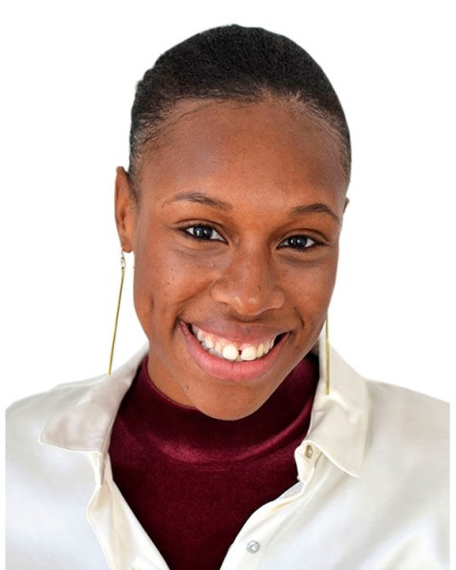

Passive Language vs.
Confident Language
I am sorry to ask you this but I was wondering if you could possibly finish the report by Friday, if you have time?
Please complete the report by Friday. Thank you.

Slide 13
Let’s Practice
Sorry, the calendar is full that day……
Sorry, for the inconvenience….
Sorry, I don’t understand your request….
Sorry, can I ask a question....
Sorry, I disagree…….

Slide 14
Breakout Rooms
How can you re-word these statements so that the word “sorry” is not part of the communication?
We will ask a few of your to share when we get back-
You will have five minutes-

Slide 15
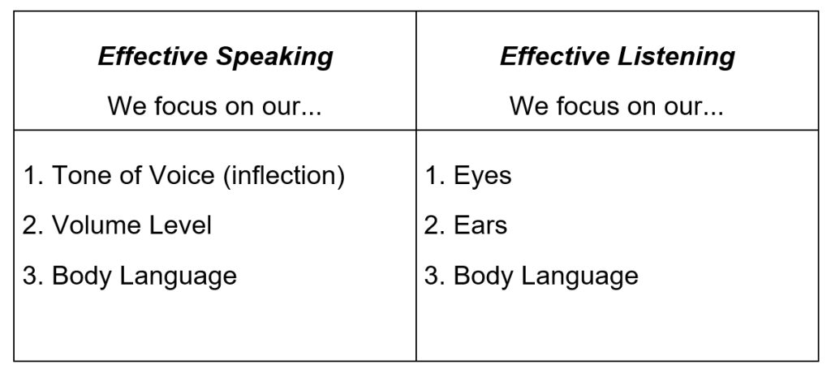
Some Alternative Phrases
Thank you for your patience.
Rather than apologizing for your busy schedule, thank your recipient for their ability to work with you.
I appreciate your flexibility.
I appreciate your understanding.
Let me make it right.
Thank you for working with me.
I know I’ve had to reschedule this meeting several times. Thank you for understanding.
The project took longer than I expected. I’ll have it for you first thing tomorrow.
I understand your frustration.
I appreciate you bringing that to my attention.

Slide 16
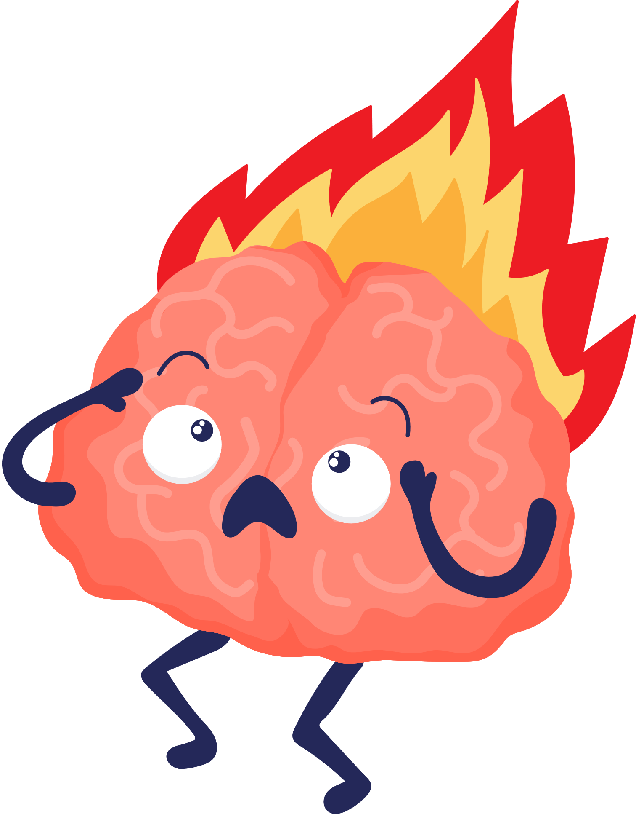
Practice Self-Compassion, Mindfulness, and Reflection
How do I Avoid Burnout?!
Build Resilience

Slide 17
What the Research Says about Burnout
  Burnout is a psychological syndrome emerging as a prolonged response to chronic interpersonal stressors on the job and causes exhaustion, cynicism, detachment, ineffectiveness, and lack of motivation (Maslach & Leiter, 2016, p. 103)
  Burnout is associated with cognitive impairment in attention and memory (Deligkaris, Panagopoulou, Montgomery, & Masoura, 2014).

Slide 18
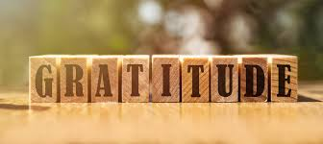
Notes:
Take 1 minute to think about how you would define Gratitude- what is your 1 word definition of gratitude (chat)

Slide 19
Blessings
Gratefulness
Praise
Kindness
Compassion
Serenity
Positivity
Joy
Love
Warmth
Notes:
The state of being grateful: Thankfulness

Slide 20
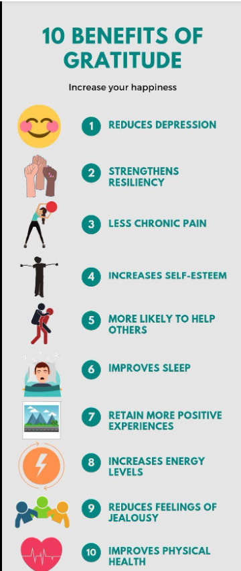
The Science of Gratitude
  Gratitude is one of our most powerful emotions. Studies show that when we practice gratitude consistently, we experience physical benefits, such as a stronger immune system and lowered symptoms of stress (Sansone & Sansone, 2010).
  Practicing gratitude isn’t about ignoring negative emotions- practicing gratitude magnifies positive feelings more than it reduces negative feelings (Robert Emmons).
  Helps with seeing the bigger picture and being more resilient during adversity.
Notes:
stronger relationships- improved self-esteem- decreased stress- greater life satisfaction

Slide 21
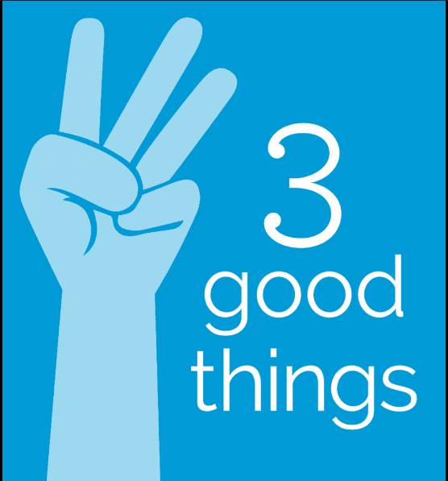
A study of the “Three Good Things” practice found that people who wrote down three things that had gone well in their day and identified the causes of those good things were significantly happier and less depressed, even 6 months after the study ended.

Slide 22
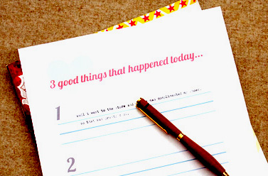
Three Good Things Exercise
  Every night, take 5 minutes to reflect on your day.
  Think of 3 good things that happened in your day.
  In a journal (or notes app on your phone) write the three good things down.
  Repeat nightly
Notes:
Breakout groups:
3 mins to write 3 good things that happened so far today (or yesterday).
10 mins to share out: Be sure to share how you felt after writing your 3 good things!

Slide 23
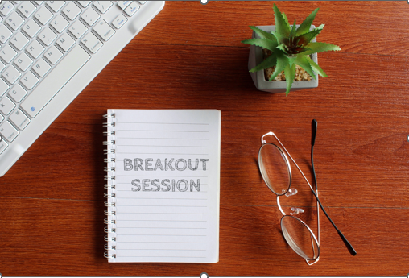
3 mins to write 3 good things that happened so far today (or yesterday).
Time to share out: You do not have to share your 3 good things but be sure to:
Share how you felt after writing your 3 good things!
Was this easy or hard for you? Why?
Will you incorporate this into your daily practice? How?

Slide 24

One Word Summary
This Photo by Unknown Author is licensed under CC BY-SA-NC

