Slide 1

New Member Onboarding
MASC Learning Lunch
February 6, 2026
School Committee Members

Slide 2
Today’s Agenda:
MA Requirements for New Committee Members
Helpful Committee Documents
Helpful District Documents
Helpful MASC Resources
District Resources for Handbooks and Protocols
Additional Onboarding Best Practices

Slide 3

MA Requirements for New
School Committee Members
School Committee Members
Sworn in by municipal clerk
Must be done prior to first official meeting
State ethics training
      30 minutes, online
Must be renewed every 2 years

Slide 4

MA Requirements for
New School Committee Members
School Committee Members
Charting the Course
    8 hours of foundational training
    Roles and Responsibilities, Ethics, OML,
    and more
Held around the state
      Governance workshops do not replace CtC

Slide 5
Helpful Committee Documents to Provide New Members
School Committee Members
Policy manual
Handbooks
Contracts
District calendars
Operating protocols
Robert’s Rules
Recent agendas
Year long agenda

Slide 6

Helpful District Documents to Provide New Members
School Committee Members
Flow chart and/or chain of command
Strategic plan and school improvement plans
Portrait of a graduate
District calendar

Slide 7
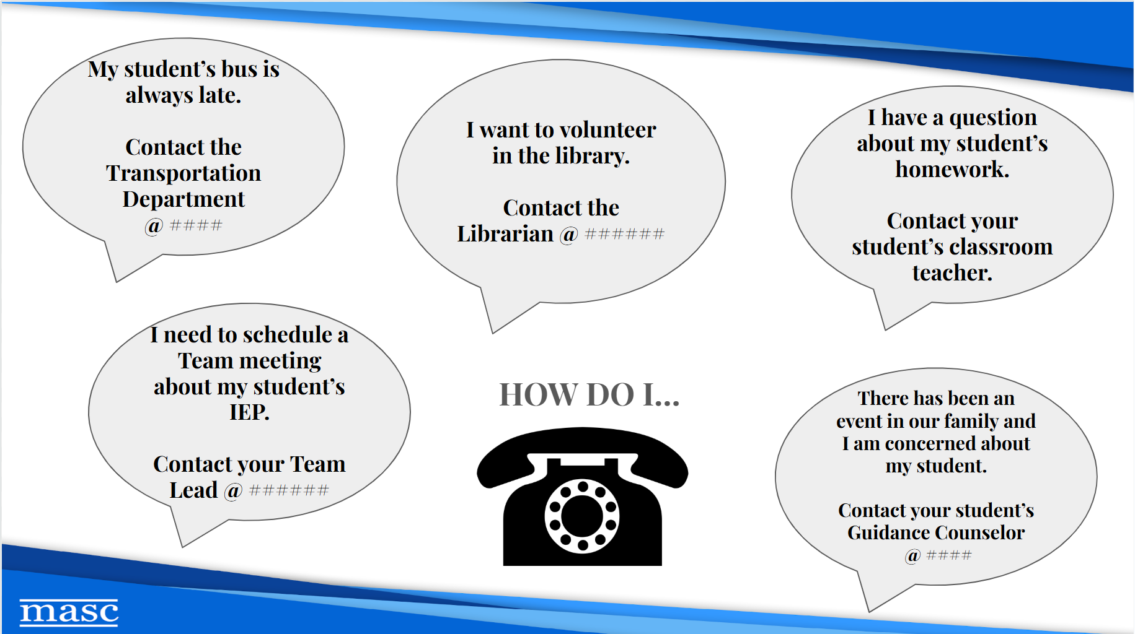

Slide 8
Helpful MASC Documents and Links
MASC Code of Ethics
MASC Handbook
Model policy manual –
under the “Services” tab
Division lists and contact information
Sign up for our ListServ
Sign up for our emails
Trainings
Educational news alerts Policy updates
The Daily Ed

Slide 9
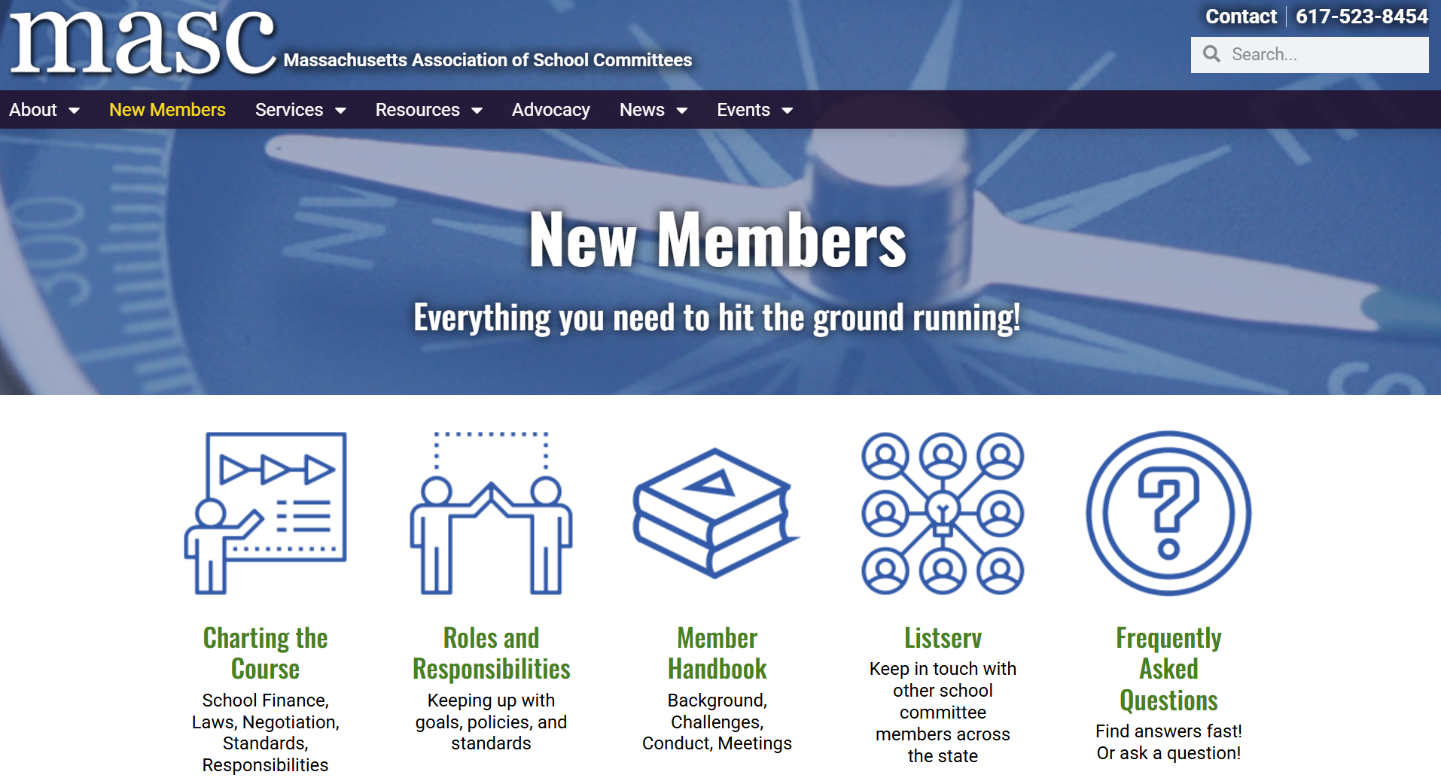

Slide 10
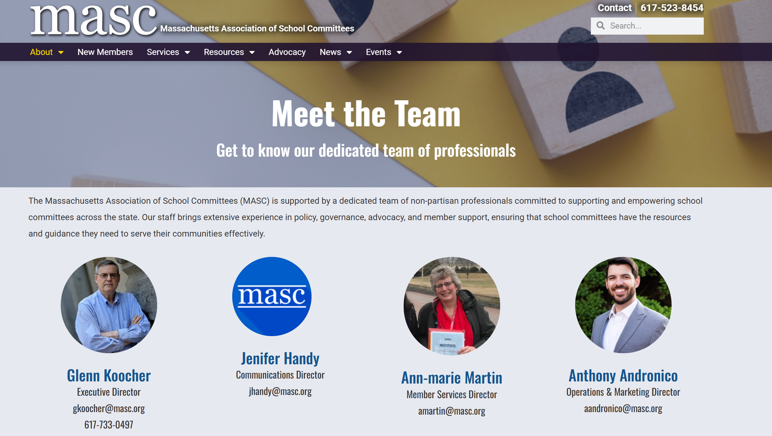
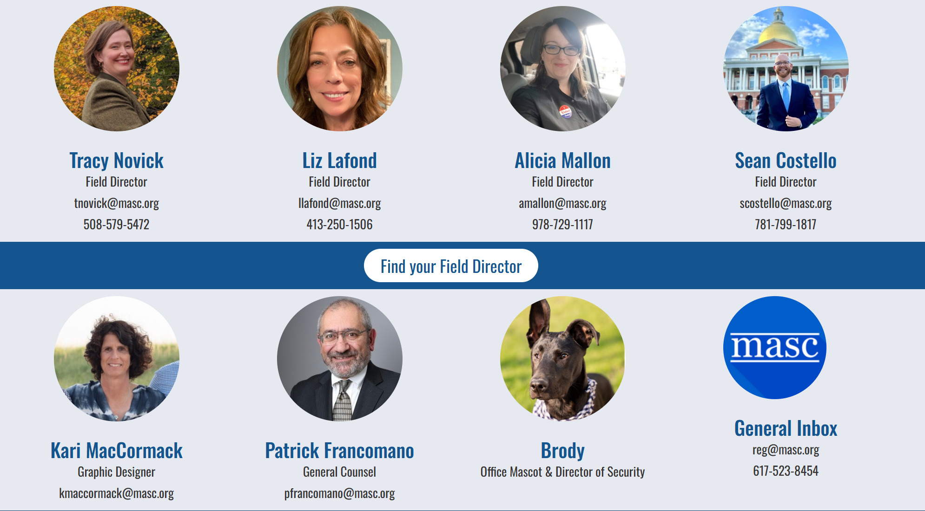
MASC
Resources,
Staff,
And Your Friendly Neighborhood
Field Directors

Slide 11
District Resources for
Handbooks and Protocols
School Committee Members
Handbooks:
Chelmsford
Sudbury
Natick
Andover
Holbrook
Norwood
Protocols:
Westford
Sudbury
Falmouth
Andover
Worcester
Lynn

Slide 12
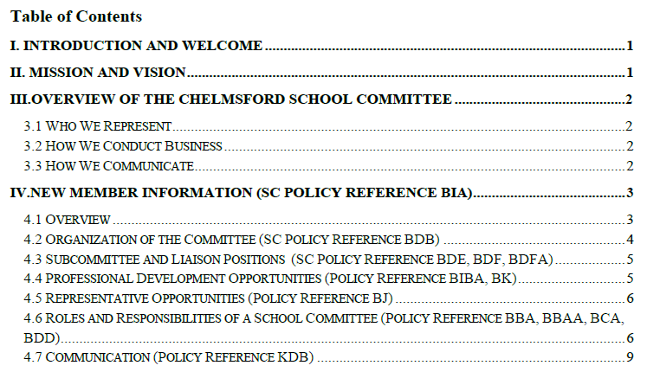

Slide 13
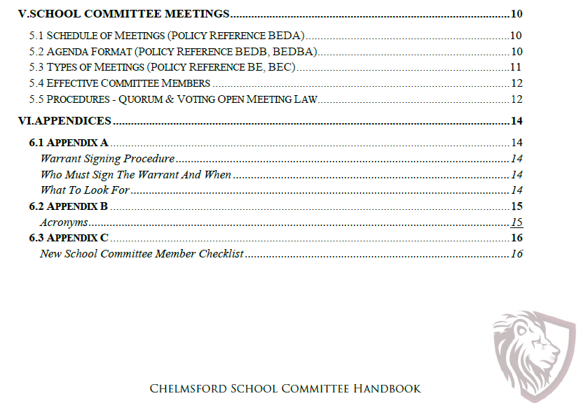

Slide 14
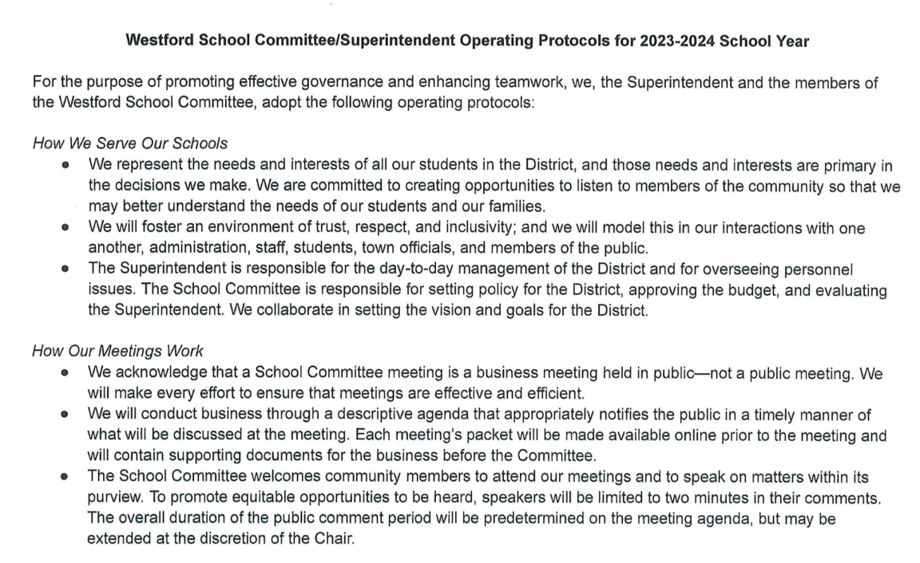
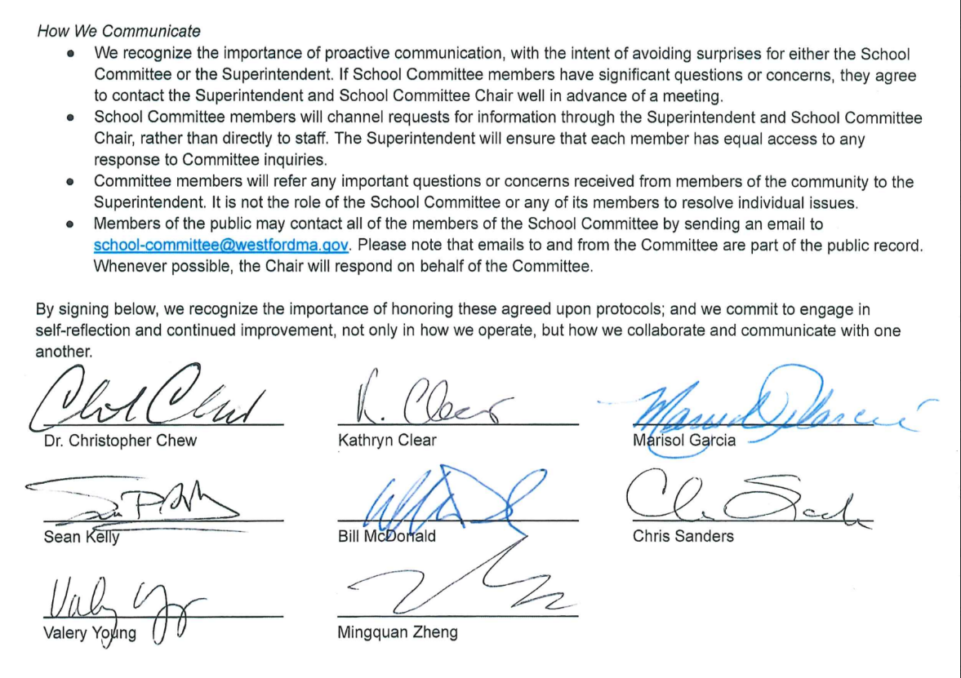

Signed by all Members
AND the Superintendent.

Slide 15
Suggested
Onboarding Processes:
Meeting with the Chair/Vice Chair
        ID photographs
              CORI paperwork
District email/platforms tutorial
Introductions with relevant administrators
Tour of buildings
Meeting with Superintendent
A 30-60-90 checklist
Adapted from: Nashoba Tech and Concord-Carlisle

Slide 16


Slide 17
Upcoming MASC Events:
Learning Lunches:
February 27 @ 12:00 pm - 2:00 pm
Team Data Application (Session 2 of 2)
March 27 @ 12:00 pm - 1:00 pm
Legislative Update
March 6 @ 12:00 pm - 1:00 pm
Budgeting as a School Committee
Charting the Course:
March 7 @ 8:00 am - 4:00 pm
Petersham
March 21 @ 8:00 am - 4:00 pm
Worthington
March 13 @ 12:00 pm - 1:00 pm
Division III Meeting: Chapter 70 & the Student Opportunity Act
March 30
MASC Day on the Hill 2026

Slide 18
Massachusetts Association of School Committees
MASC.org
One McKinley Square
Boston, MA 02109
617-523-8454
Alicia (Curtin) Mallon
MASC Field Director/Search Coordinator
AMallon@MASC.org
(978) 729-1117

